Slide 1
TOPIC 10 – INTERNET

Slide 2
Overview
The origin of the Internet.
Internetworking.
Connections.
Internet services.
The World Wide Web and HTML.
Dynamic HTML and XML.
Multimedia on the Web.

Slide 3
The origin of the internet
The Internet began as a research network funded by the Advanced Research Projects Agency (ARPA) of the U.S. Defense Department in 1969.
In 1989, the National Science Foundation (NSF) took over the management of the ARPANET.
By the mid 1990s, the Internet included connections to more than 60 countries and more than 2 million host computers with more than 15 million users worldwide.

Slide 4
(cont.) The origin of the internet
In 2017, there were 162,713,051 domain hosts and 407.1 million users of the Internet, representing 6.71 percent of the world’s population.
By the beginning 2010, about one out of every four people around the world has access to the Internet, and more than 51 million domain names had been registered as ‘dot coms’.

Slide 5
Internetworking
A network is a cluster of computers.
In a network, the server computer provides network services to the client computers on that network.
Several LANs can be interconnected using gateways and routers to form a wide area network (WAN).
LANs and WANs can be connected to the Internet through a server that provides Internet software and physical data connection.

Slide 6
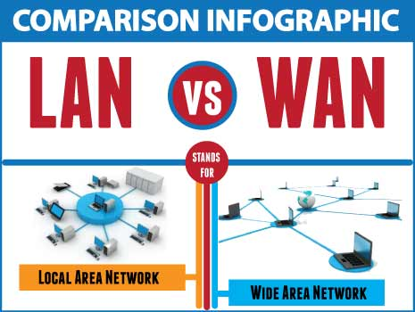
Internetworking

Slide 7
(cont.) Internetworking
Internet addresses.
TCP/IP (Transmission Control Protocol / Internet Protocol).

Slide 8
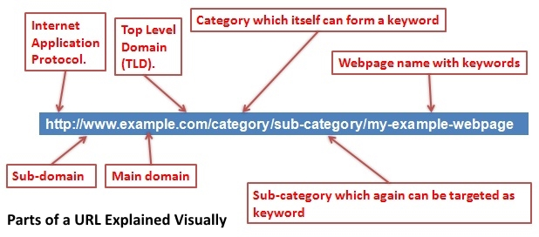
(cont.) Internetworking
http://www.uitm.edu.my
protocol
service
domain name
Top Level Domain
Country code

Slide 9
Internet Address
When the original ARPANET protocols for communicating among computers were remade into the current scheme of TCP/IP, in 1983, The Domain Naming System (DNS) was developed to assigns names and addresses to computers linked to the Internet.

Slide 10
Internet Address
Top-level domains (TLDs) were established as categories to accommodate Internet users.
com – commercial entities
edu – degree-granting colleges and universities
gov – government agencies
net – computers belonging to network providers.
biz – business entities
org - organization

Slide 11
(cont.) Internet Address
The two-letter US domain is based on political boundaries.
Second level Domains – contain huge numbers of computers and user accounts representing local, regional, and even international branches as well as various internal business and management functions.

Slide 12
TCP/IP
Transmission Control Protocol (TCP) and Internet Protocol (IP) are the protocols for communication on the Internet.
A stream of data that is sent over the Internet is first broken down into packets by the TCP.
After a packet is created by TCP, the internet protocol (IP) then takes over and actually sends the packet to its destination along a route that may include many other computers acting as forwarders.
TCP/IP is two important Internet protocols working in concert.

Slide 13
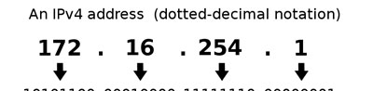
IP address
The 32-bit address included in a data packet, the IP address, is a “real” Internet address. It is made up of four numbers separated by periods.
Example : 140.174.162.10
These numbers are assigned by Internet authorities and some may be assigned by Internet Service Provider (ISP).

Slide 14
(cont.) TCP/IP
Data packets include the receiving computer's address, a sequence number, error correction information, and a small piece of data.
IP is responsible for sending the packet to its destination along a route.

Slide 15
Connections
A telephone dial-up account and modem, a cable modem, or a Digital Subscriber Line (DSL) is required for network connection.
An ISP (Internet Service Provider) offers one or more Points of Presence (POPs) to connect to the ISP's server.
The PPP (Point-to-Point Protocol) and the TCP/IP software are required to connect to the Internet through an ISP.

Slide 16
(cont.) Connections
The amount of data expressed in terms of bits per second (bps) you can send from one computer to another in a given time is referred as bandwidth.
The greater the bandwidth, the lesser will be the time taken for text, images, sounds, animated illustrations to upload or download from computer to computer.
Low-bandwidth modem connections are a bottleneck for sending multimedia across the Internet.

Slide 17
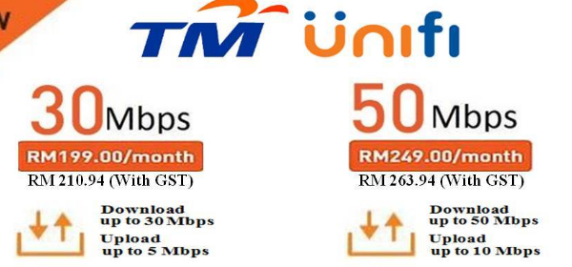
Internet Bandwidth in Malaysia

Slide 18
Bottleneck

Slide 19
(cont.) Connections
Type of connection | Bandwidth (bits per second) | Comment
28.8 K modem | 28,800 | Max.analog modem spped over cooper wire
56 K Modem | 56,000 – 128,000 | Data compressed
ISDN | 56,000 – 45,000,000 | Integrated Services Digital Network
Wireless (802.11) | 3,000,000 – 54,000,000

Slide 20
(cont.) Connections
Bandwidth bottlenecks can be avoided using the following options:
Compress data before transmitting.
Oblige users to download data only once, and then store that data on the system's hard disk.
Design multimedia elements to be efficiently compact.

Slide 21
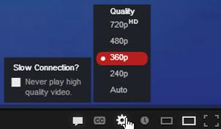
(cont.) Connections
Bandwidth bottlenecks can be avoided using the following options (CONTINUE):
Design alternate low-bandwidth and high-bandwidth navigation paths to accommodate all users.
Implement incremental streaming methods.

Slide 22
Internet Services
To many users, the Internet means World Wide Web, but the Web is only the latest and most popular services.
Email, file transfer, discussions groups, real-time chatting by text, voice, video are common as well.
Each Internet service is implemented on an Internet server by dedicated software known as a daemon.
Daemons are agent programs that run in the background and wait to act on requests.

Slide 23
(cont.) Internet Services
Daemons supports services such as Hypertext Transfer Protocol (HTTP) for World Wide Web, Post Office Protocol (POP) for email or File Transfer Protocol (FTP) for exchanging files.

Slide 24
(cont.) Internet Services
The other services provided by the Internet include
https – for posting and reading encrypted secure documents,
ftp – for transferring files between computers (anonymous or password protected) ,
gopher, usenet, telnet, Internet Relay Chat (IRC), Simple Mail Transport Protocol (SMTP), and mud.

Slide 25
(cont.) Internet Services
Recognizable documents and formats are required to work with multimedia on the Internet.
MIME (Multipurpose Internet Mail Extensions) type is a standard list of file name extensions.
It identifies the nature and purpose of the transmitted data.

Slide 26
The World Wide Web
The World Wide Web was designed by Tim Berners-Lee.
It is a protocol for linking multiple documents located on computers anywhere within the Internet.
The Hypertext Transfer Protocol (HTTP) provides rules for a simple transaction between two computers on the Internet.
Hypertext Markup Language (HTML) is a document format for presenting structured text mixed with inline images.

Slide 27
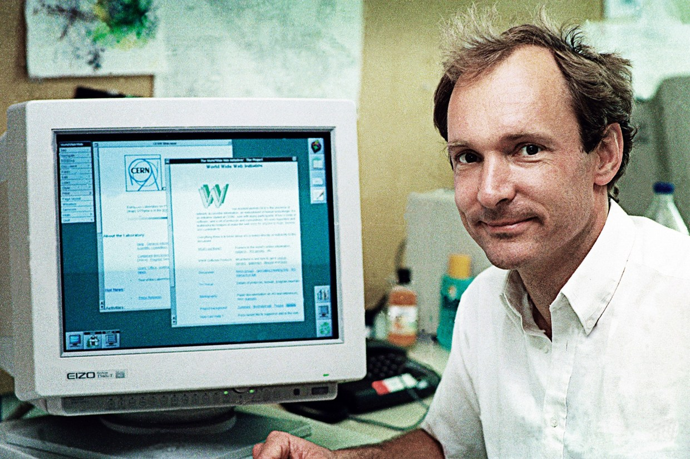
The World Wide Web

Slide 28
Dynamic HTML and XML
An HTML (Hypertext Markup Language) document could contain hyperlinks or anchors that referred to other similar documents.

Slide 29
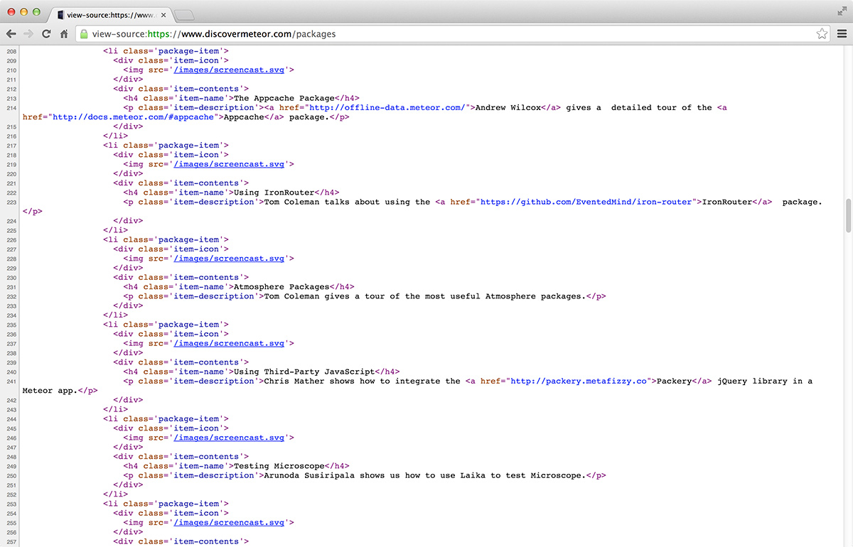
Dynamic HTML and XML

Slide 30
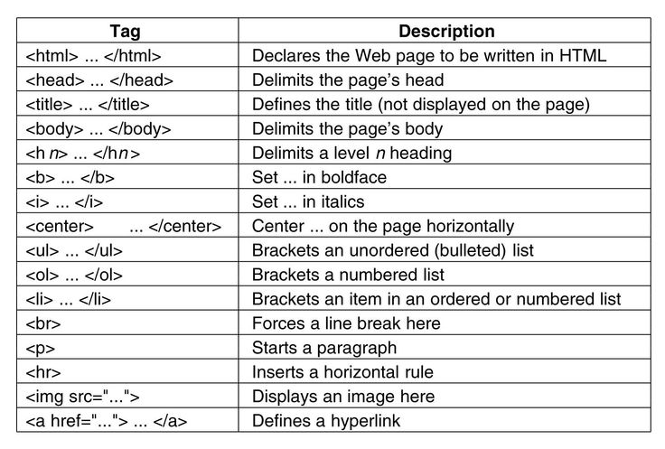
Dynamic HTML and XML

Slide 31
Dynamic HTML and XML
HTML is fine for building and delivering uncomplicated static web pages. But you will need other tools and programming to deliver dynamic pages that are built from text, graphics, animations, and information contained in database or documents.
JavaScript may be inserted into HTML pages to perform special functions and tasks that beyond HTML abilities.

Slide 32
(cont.) Dynamic HTML and XML
Dynamic Web pages can be created using Cold Fusion, PHP, JavaScript, and programs written in Java.
XML (eXtensible Markup Language) is used to format and delivery Web pages using styles. Unlike HTML, you can create your own tags in XML to describe exactly what the data means.

Slide 33
Multimedia on the web
Designing effective multimedia for the Web includes:
Presenting text, images, audio, and animation in a user-friendly interface that balances bandwidth deficits.
Understanding how to deliver multimedia content for HTML browsers and plug-in/player vehicles.
Enhanced capabilities provided by XML, Java, JavaScript, plug-in as FlashPlayer, QuickTime to enable browser to exceed their limit.

Slide 34
Tools for the World Wide Web
Web servers (hosting)
Web browsers ( chrome, IE,firefox,safari)
Search engines(google,bing,yahoo,baidu)
Web page makers and site builders
Plug-ins and delivery vehicles

Slide 35
Summary
The Internet connects private companies, organizations, universities, and individuals.
The Internet is a cluster of computers.
ISPs provide network connections through a dial-up account, a cable modem, or a Digital Subscriber Line (DSL).

Slide 36
(cont.) Summary
The Domain Name System (DNS) manages the identities of computers connected to the Internet.
HTTP provides rules for contacting, requesting, and sending documents encoded with the Hypertext Markup Language (HTML).
JavaScript, Cold Fusion, and XML can be used to generate dynamic Web pages.

