Slide 1
TOPIC 1– INTRODUCTION TO MULTIMEDIA
Arranged by :
MOHD SAIFULNIZAM ABU BAKAR
saiful.uitm.edu.my

Slide 2
Overview
Introduction to multimedia.
Definition
Types of multimedia
Delivering multimedia
Why multimedia?
Applications of multimedia.
Examples of multimedia application
Summary

Slide 3
Objectives
At the end of this chapter, students should be able to:
define basic terms and concepts related to multimedia technologies
distinguish between the types of linear and non-linear multimedia systems
identify various applications of multimedia

Slide 4
Introduction to Multimedia
The definition of Multimedia :
“Multimedia is any combination of text, art, sound, animation, and video delivered to you by computer or other electronic or digitally manipulated means. A multimedia project development requires creative, technical, organizational, and business skills.”
Tay Vaughan
Multimedia : Making it work 8th Ed.

Slide 5
Multimedia is a combination of
Notes:
Images sources : http://informatikarenbilakaera.blogspot.com/2011/05/multimedia.html

Slide 6
Retention rate
Studies indicate that if you’re stimulated with audio, you will have about a 20 percent retention rate. With audio-visual, retention is up to 30 percent and in interactive multimedia presentations, where you are really involved, the retention rate is as high as 60 percent.

Slide 7
Multimedia Terminologies
Interactive Multimedia: when a user is given the option of controlling the elements.
Hypermedia: when a user is provided a structure of linked elements for navigation.
Multimedia Developer : The people that develop multimedia projects.

Slide 8
Multimedia Terminologies
The software vehicle, the messages, and the content together constitute a multimedia project.
A multimedia project shipped to end-users with or without instructions is called a multimedia title.
A project can also be launched on the Web.

Slide 9
Introduction to Multimedia
Types of Multimedia projects :
Linear Multimedia: Projects that are not interactive. Users have very little control over the presentation
Nonlinear (interactive) Multimedia : Projects that are user-interactive, where users are given navigational control.

Slide 10
Introduction to Multimedia
1-Linear Multimedia
users can sit back and watch it just as they do a movie or the television
The presentation normally plays from the start to end or even loops continually to present the information.
A movie is a common type of linear multimedia.
Demo show, non interactive lecture

Slide 11
Introduction to Multimedia
2- Non linear (interactive) multimedia
When users are given navigational control and can wander through the content at will
Advantage: complex domain of information can be presented.
Disadvantage: users might lost in the massive “information highway”.
Useful for: information archive (encyclopedia), education, training and entertainment.

Slide 12
Non linear (interactive) multimedia
Non linear means
Interactive
Users have control over the contents
Users are given navigation control
Example
Games , course ware , interactive CD

Slide 13
Introduction to Multimedia
Multimedia Projects can also be delivered online (webs) and through PDAs/Hand-held Devices.
The primary media for delivering multimedia projects are:
Compact disc read-only (CD-ROM)
Digital Versatile Disc (DVD) / Blu-ray disc (BDA)

Slide 14
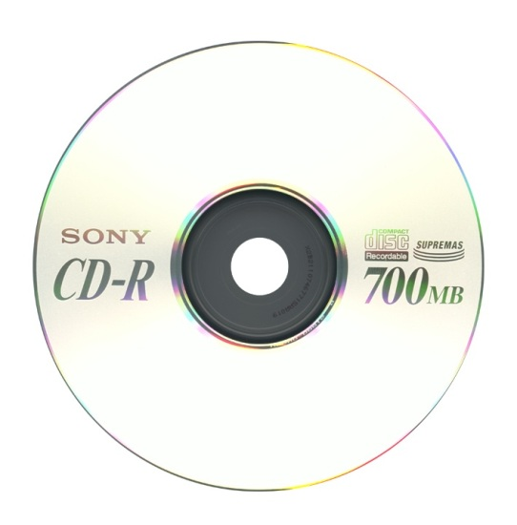
CD-ROM
The most cost-effective distribution medium for multimedia projects.
It can contain up to 80 minutes of full-screen video or sound.
capacity 700MB

Slide 15
DVD-ROM / Blu-ray disc
Multilayered DVD technology increases the capacity of current optical technology to 18 GB.
DVD authoring and integration software is used to create interactive front-end menus for films and games.
Blu-ray disc (Blu-ray Disc Association BDA) is next-generation format for high-definition video and high-density data. A single-layer disc can fit 23.3, 25, or 27 GB (enough for approximately four hours of high-definition video with audio). It supports 25GB for one layer, 50GB for two and 100GB for four

Slide 16
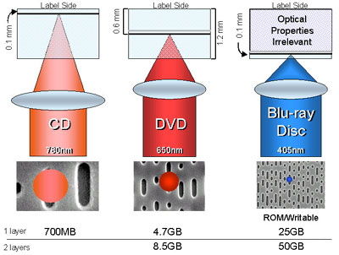
Comparison
 | CD | DVD | BLU-RAY
Capacity | 700MB | Up to 8.5 GB | Up to 120 GB

Slide 17
CD and DVD burners Software
Both CD and DVD burners are used for reading discs and converting the discs to audio, video, and data formats.

Slide 18
Why Multimedia?
Ease of use
Intuitive Interface
Immersive experience
Self-paced interaction and better retention
Better understanding
Cost effectiveness
More fun

Slide 19
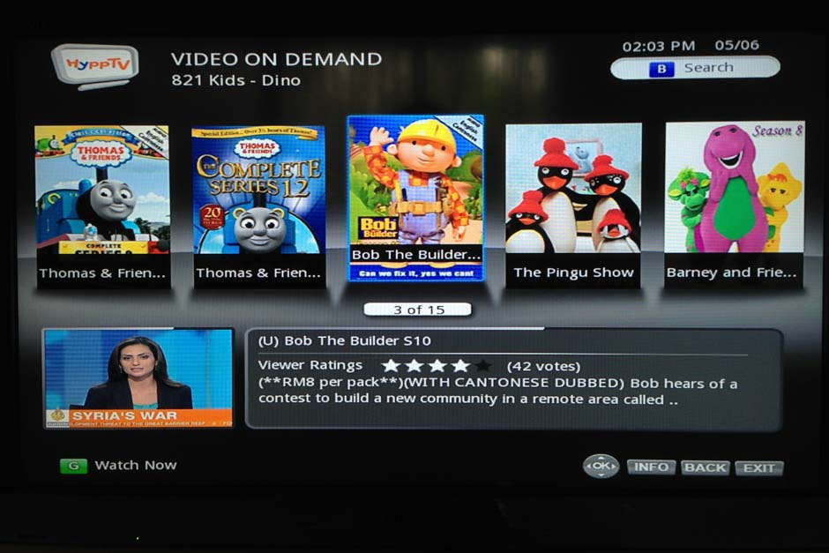
Applications of Multimedia
Home
Most multimedia projects reach the homes via television sets or monitors with built-in user inputs.
Movies on demand, games, instructional videos on gardening etc.
Notes:
Image source - http://www.americanavca.com/man_watching_television.png

Slide 20
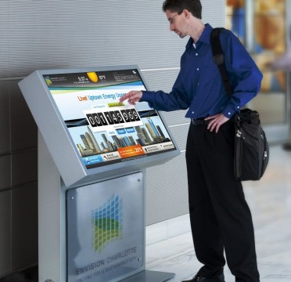
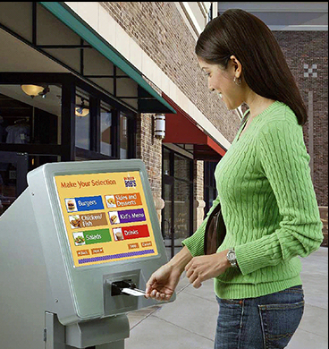
Applications of Multimedia
Public places
Multimedia will become
available at stand-alone
terminals or kiosks
to provide information
and help.
Notes:
Image source - http://www.squidoo.com/multimedia-kiosks

Slide 21
Applications of Multimedia
Business
Business applications include presentations training, marketing, advertising, product demos, databases, catalogues, instant messaging, and networked communication.

Slide 22
Schools
Educational software can be developed to enrich the learning process
move away from the transmission or passive learner model of learning to the experiential learning or active-learner model.

Slide 24
Examples of Multimedia Application
Digital video editing and production systems
E-Newspapers /Magazines
Games
Groupware
Home shopping
Interactive TV
Multimedia courseware
Video conferencing
Video-on-Demand
(VoD)
Virtual reality

Slide 25
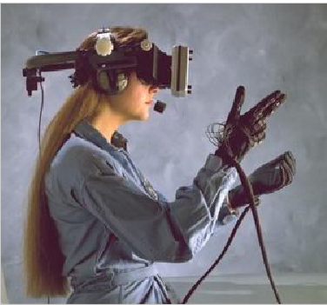
Virtual Reality
Virtual reality is an extension of multimedia.
It uses the basic multimedia elements of imagery, sound, and animation.
It requires terrific computing horsepower to be realistic.

Slide 26
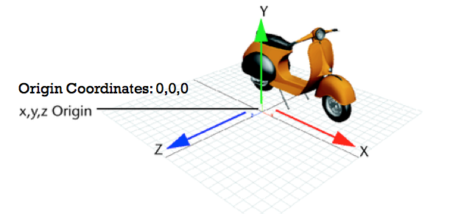
(cont.) Virtual Reality
In VR, cyberspace is made up of thousands of geometric objects plotted in three-dimensional space.
The standards for transmitting VR in Virtual Reality Modeling Language (VRML) documents have been developed on the World Wide Web.
Emirates A380

Slide 27
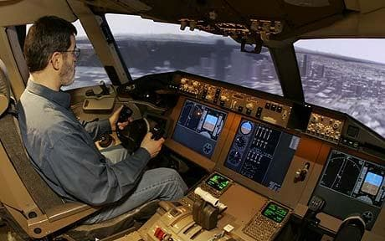
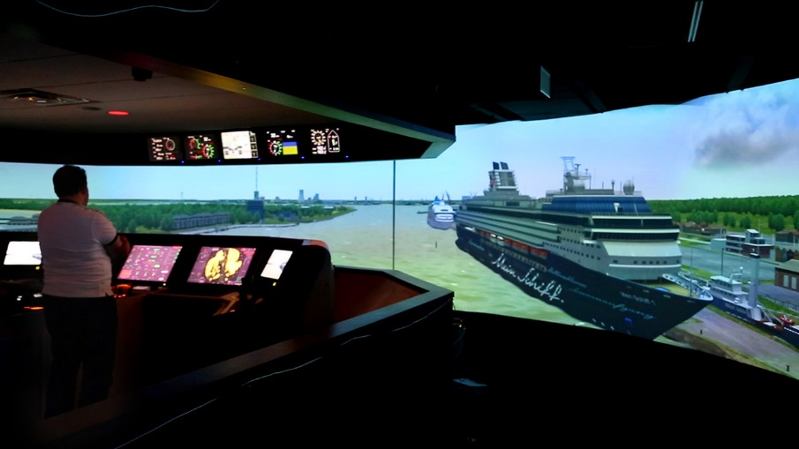
Examples:
Flight simulators
Surgery simulators
Computer-controlled simulators teach the intricate loading and unloading of oil tankers and container ships (maritime academy).

Slide 28
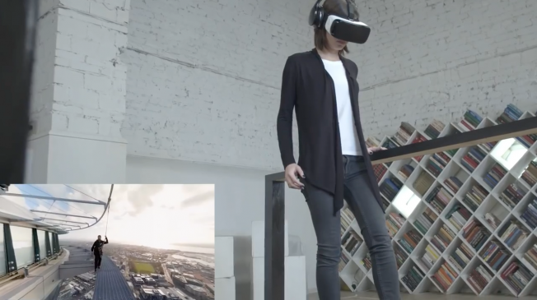
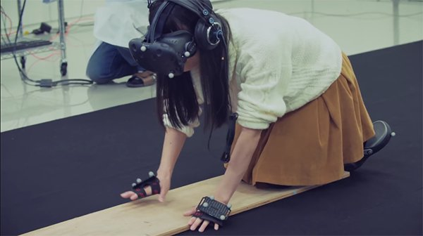
Acrophobia - extreme fear of heights
Train your phobias away with realistic simulations

Slide 29
Summary
Multimedia is a combination of text, graphic art, sound, animation, and video.
There are two types of multimedia projects : linear or nonlinear.
Multimedia projects are often stored on CD-ROM or DVDs. They can also be hosted on the Web.
Multimedia is widely used in business, schools, public places, and at home.
Virtual reality is an extension of multimedia

