Slide 1
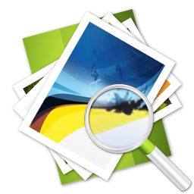
TOPIC 4 - GRAPHICS
Arranged by :
MOHD SAIFULNIZAM ABU BAKAR
saiful.uitm.edu.my

Slide 2
Overview
Creation of multimedia images.
Creation of still images.
Colors and palettes in multimedia.
Image file types used in multimedia

Slide 3
Creation of Multimedia Images
Before commencing the creation of images in Multimedia, one should:
Plan their approach using flow charts and storyboards.
Organize the available tools in authoring system.
Configure your computer workspace : have multiple monitors, for lots of screen real estate (viewing area).

Slide 4
Creation of Still Images
Still images may be the most important element of a multimedia project.
The type of still images created depends on the display resolution, and hardware and software capabilities.
Still images are generated by the computer in two way: bitmaps (or paint graphics, raster image) and vector-drawn (or just plain ”drawn”)

Slide 5
(cont.) Creation of Still Images
There are two types of still images
3-D drawing and rendering.
Still Images
Bitmaps
Vector Drawn

Slide 6
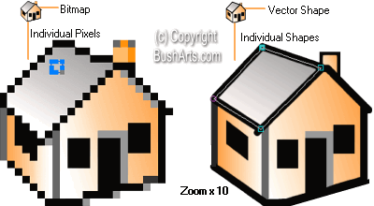

Slide 7
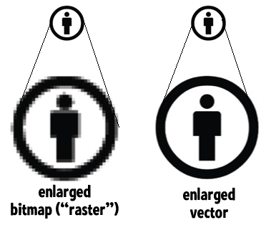
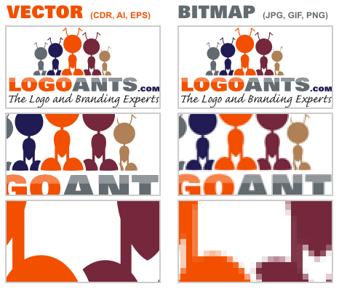

Slide 8
Bitmaps
Bitmap is derived from the words ‘bit’, which means the simplest element in which only two digits (1,0) are used, and ‘map’, which is a two-dimensional matrix of these bits.
A bitmap is a data matrix describing the individual dots of an image.
Bitmaps Definition : simple matrix of the tiny dots that form an image and are displayed on a screen or printed

Slide 9
Bitmaps
Bitmapped images are known as paint graphics.
A bitmap is made up of individual dots or picture elements known as pixels or pels.
Bitmapped images can have varying bit and color depths.

Slide 10
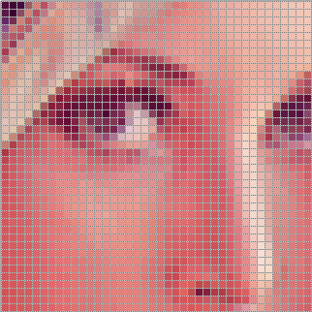
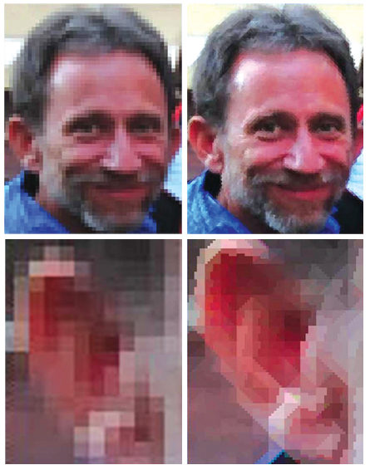
pixels

Slide 11
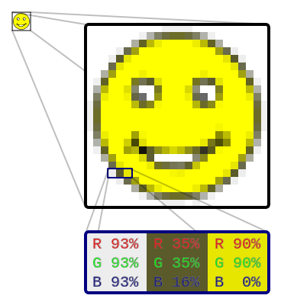
(cont.) Bitmaps
The smiley face is a bitmap image. When enlarged, individual pixels appear as squares. Zooming in further, they can be analyzed, with their colors constructed by adding the values for red, green and blue.

Slide 12
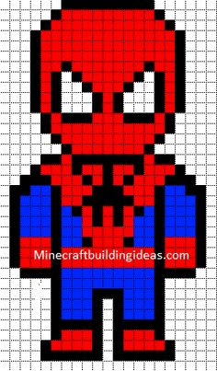
(cont.) Bitmaps
Bitmaps are an image format suited for creation of:
Photo-realistic images.
Complex drawings.
Images that require fine detail.

Slide 13
(cont.) Bitmaps
Available binary Combinations for Describing a Color

Slide 14
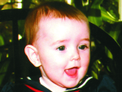
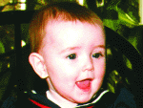
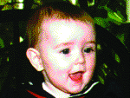
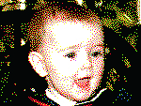
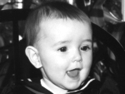
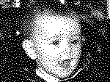
Creation of Still Images (continued)
24 bits depth.
Millions of colors.
Dithered to 8 bits.
Adaptive palette of 256 colors.
Dithered to 8 bits.
Macintosh palette of 256 colors.
Dithered to 4 bits.
16 colors.
Available binary Combinations for Describing a Color
Dithered to 8-bit gray-scale.
256 shades of gray.
Dithered to 4-bit gray-scale.
16 shades of gray.
Dithered to 1-bit.
Two colors, black and white.

Slide 15
Bitmaps picture and their suitability of use:-
Use JPEG, for photo sharing on the web because of its size and quality.
GIF is normally used for diagrams, buttons, etc., that have a small number of colours
It is also suitable for simple animation because it supports interlaced images.
PNG is almost equal to gif except that it didn’t support the animation format.
GIF

Slide 16
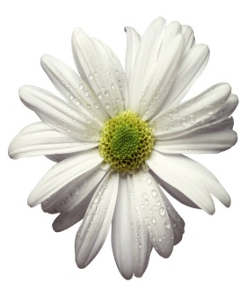
(cont.) Bitmaps
Bitmaps can be inserted by:
Using clip art galleries.
Using bitmap software.
Capturing and editing images.
Scanning images.
Clip Art

Slide 17
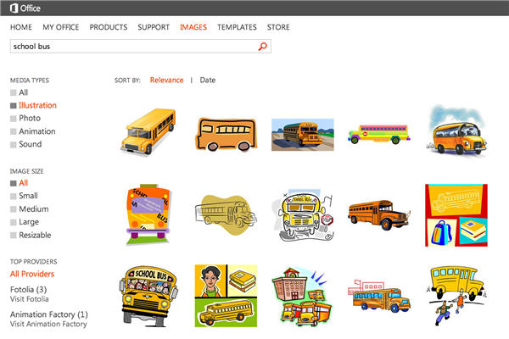
Using Clip Art Galleries
A clip art gallery is an assortment of graphics, photographs, sound, and video.
Clip arts are a popular
alternative for users who
do not want to create
their own images.
Clip arts are available
on CD-ROMs and
on the Internet.

Slide 18
Using Bitmap Software
The industry standard for bitmap painting and
editing programs are:
Adobe's Photoshop and Illustrator.
Macromedia's Fireworks.
Corel's Painter.
CorelDraw.
Quark Express.

Slide 19
Capturing and Editing Images
Capturing and storing images directly from the screen is another way to assemble images for multimedia.
Both Macintosh and Windows have a clipboard – an area of memory where data is temporarily stored when you cut or copy within application.
The PRINT SCREEN button in Windows and COMMAND-CONTROL-SHIFT-4 keystroke on the Macintosh copies the screen image to the clipboard.

Slide 20
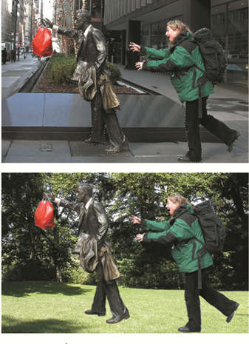
Capturing and Editing Images
Image editing programs enable the user to:
Enhance and make composite images.
Alter and distort images.
Add and delete elements.
Morph (manipulate still images to
create animated transformations).

Slide 21
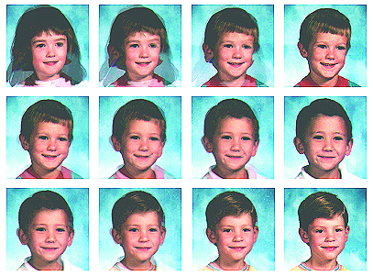
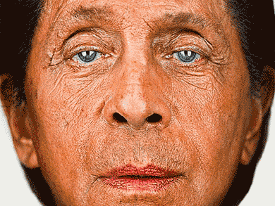
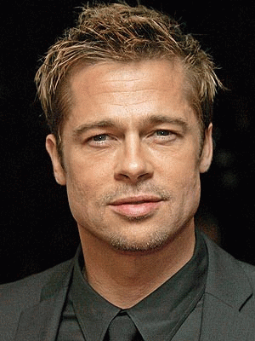
Creation of Still Images (continued)
Morphing software was used to seamlessly transform the images of 16 kindergartners. When a sound track of music and voices was added to the four-minute piece, it made a compelling video about how similar children are to each other.

Slide 22
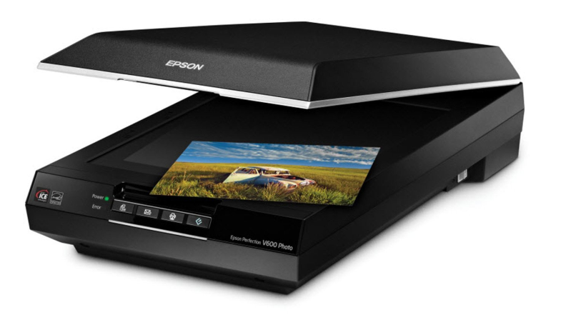
Scanning Images
Everyday objects can be scanned and manipulated using image-editing tools.
Users can scan images from conventional sources and make necessary alterations and manipulations.

Slide 23
Vector Drawn Graphics
Applications of vector-drawn images.
How vector-drawn images work?
Vector-drawn images v/s bitmaps.
Vector-drawn images are used in the following areas:
Computer-aided design (CAD) programs.
Graphic artists designing for the print media.
3-D animation programs.
Applications requiring drawing of graphic shapes.

Slide 24
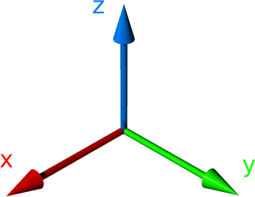
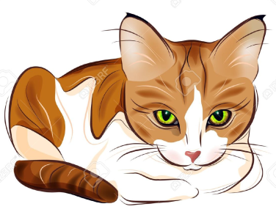
How to Draw Vector Drawn Images Work
A vector is a line that is described by the location of its two endpoints.
Vector drawing makes use of Cartesian co-ordinates.
Cartesian coordinates are numbers that describe a point in two or three-dimensional space as the intersection of X, Y, and Z axis.

Slide 25
Vector Drawn Vs Bitmaps
Vector images use less memory space and have a smaller file size as compared to bitmaps.
For the Web, pages that use vector graphics in plug-ins such as Flash download faster, and when used for animation, draw faster than bitmaps.
Vector images cannot be used for photorealistic images.
Vector images require a plug-in for Web-based display.
Bitmaps are not easily scalable and resizable.
Bitmaps can be converted to vector images using autotracing.

Slide 26
3-D Drawing and Rendering
3-D animation tools.
Features of a 3-D application.
Panoramas.

Slide 27
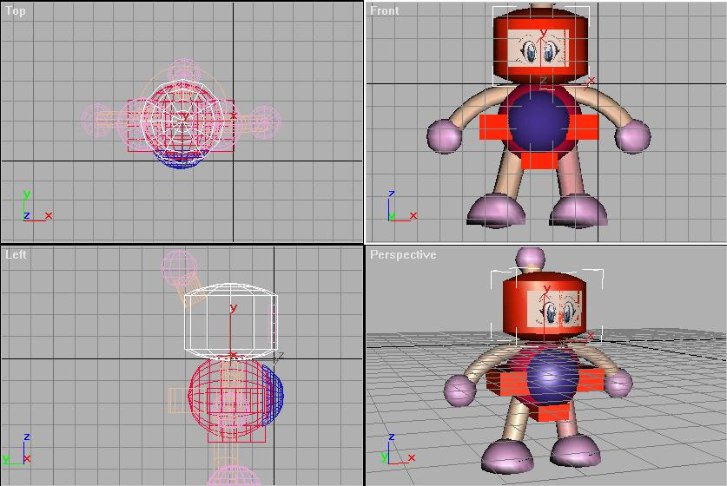
3D Drawing and Rendering
A 3D scene consist of object that in turn contain many small elements, such as blocks, cylinders, spheres or cones (described in terms of vector graphics)
The more elements, the finer the object’s resolution and smoothness.

Slide 28
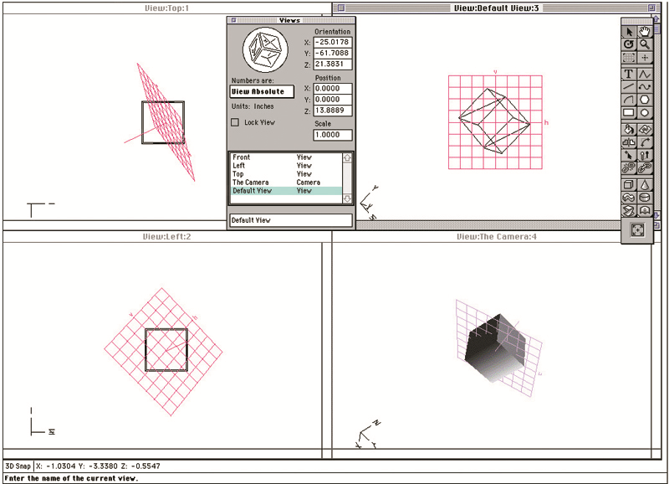
3-D Animation Tools
3-D animation, drawing, and rendering tools include:
Ray Dream Designer.
Caligari True Space 2.
Specular Infini-D.
Form*Z.
NewTek's Lightwave.
Autodesk’s Maya
Google’s SketchUp

Slide 29
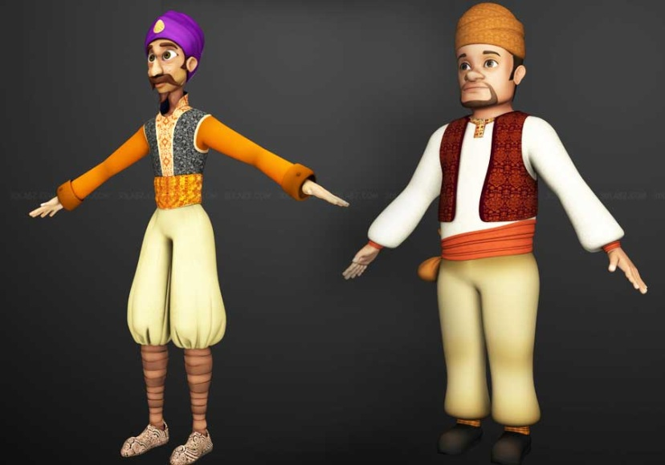
Features of 3-D applications
Modeling
placing all the elements into 3-D space.
involves drawing a shape, such as a 2D letter, then extruding it or lathing it into a third dimension.
deals with lighting, setting a camera view to project shadows

Slide 30
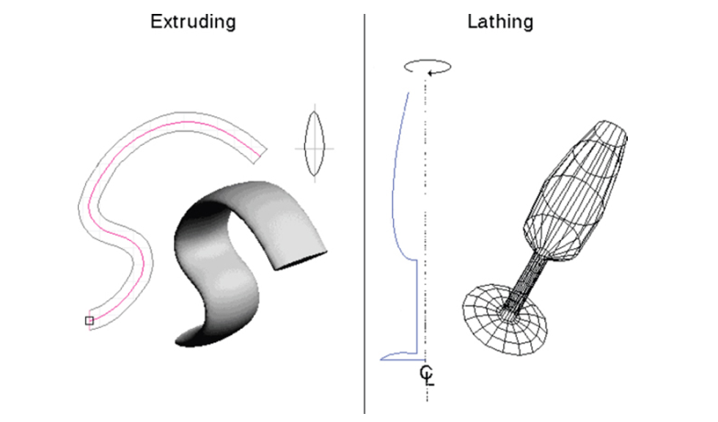
(cont.) Features of 3-D applications
Extrusion - The shape of a plane surface extends some distance.
Lathing - A profile of the shape is rotated around a defined axis.

Slide 31
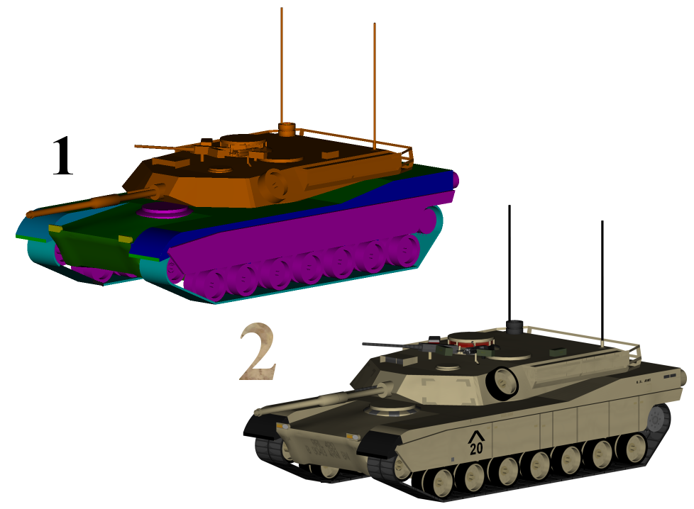
(cont.) Features of 3-D applications
Textures and colors - To make it seem more realistic- rough and coarse or shiny and smooth.

Slide 32
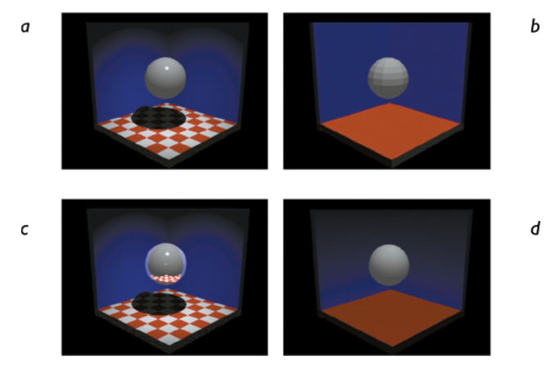
Shading
flat shading (b) is the fastest for the computer to render and is most often used in preview mode. Gouraud shading (a), Phong shading (d), and ray tracing (c) take longer to render but provide photorealistic images.

Slide 33
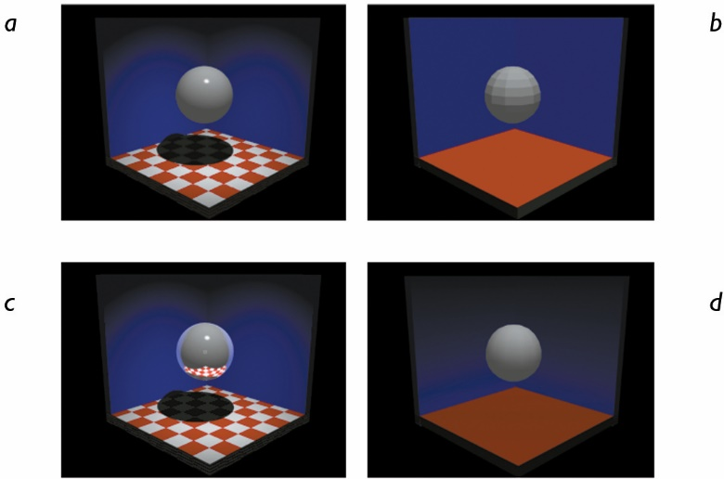
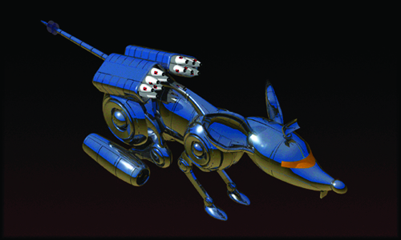
Features of 3-D applications
Rendering - Use of intricate algorithms to apply user-specified effects

Slide 34
Panoramas
Panoramic images are created by stitching together a sequence of photos around a circle and adjusting them into a single seamless bitmap.
Software such as ULead Cool 360, and Panorama Factory are required in order to create panoramas.

Slide 35
Using Panorama Factory
The Panorama Factory is a panoramic stitching program for Windows and Mac.
It creates high-quality panoramas from a set of overlapping digital images.
The Panorama Factory transforms (warps) the images so that they can be joined seamlessly into panoramas whose fields of view can range up to 360 degrees.

Slide 37
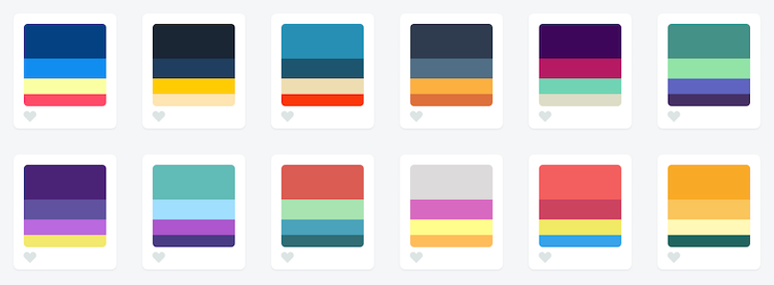
Colors and Palettes in Multimedia
Understanding natural light and color.
Color palettes.

Slide 38
Understanding Natural Light and Color
Light comes from an atom where an electron passes from a higher to a lower energy level- each atom produces uniquely specific colors.
Based on quantum theory.
Color is the frequency of a light wave within the narrow band of the electromagnetic spectrum, to which the human eye responds.
Types of computerize color
Additive color.
Subtractive color.
Monitor-specific color.
Color models.

Slide 39
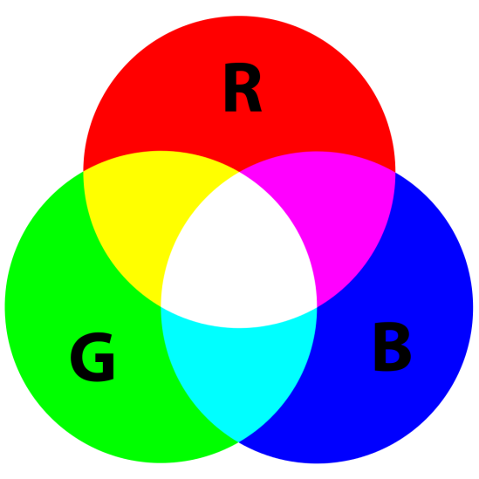
Additive Color
In the additive color method, a color is created by combining colored light sources in three primary colors - red, green, and blue (RGB).
TV and computer monitors use this method.

Slide 40
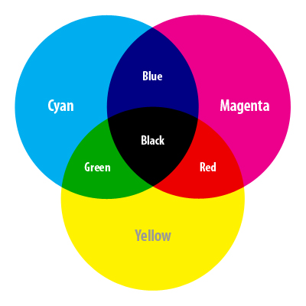
Subtractive Color
In the subtractive color method, color is created by combining colored media such as paints or ink.
The colored media absorb (or subtract) some parts of the color spectrum of light and reflect the others back to the eye.
Subtractive color is the process used to create color in printing.
The printed page consists of
tiny halftone dots of three primary
colors - cyan, magenta, and yellow
(CMY).

Slide 41
Monitor-Specific Colors
Colors should be used according to the target audience's monitor specifications.
The preferred monitor resolution is 800x600 pixels.
The preferred color depth is 32 bits.

Slide 42
Computer color models
Models used to specify color in computer terms are:
RGB model - A 24-bit methodology where color is specified in terms of red, green, and blue values ranging from 0 to 255.
HSB (hue, saturation, brightness) and HSL (hue, saturation, lightness) models – Color is specified as an angle from 0 to 360 degrees on a color wheel.
Other models include CMYK, CIE, YIQ, YUV (TV), and YCC.

Slide 43
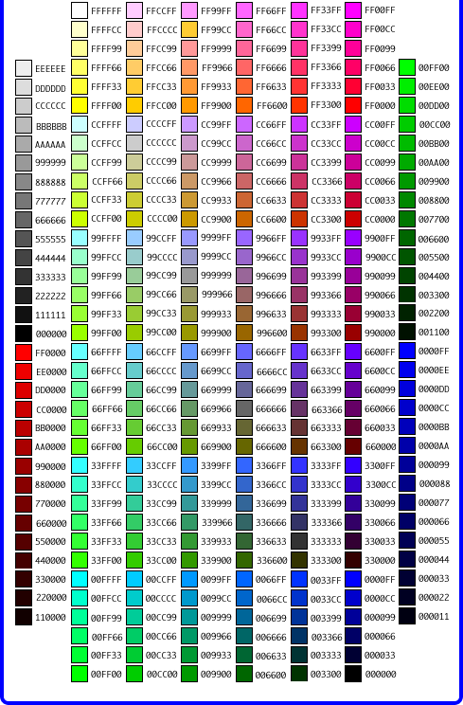
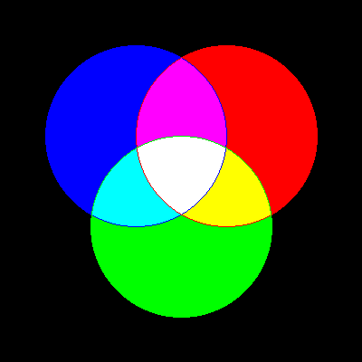
RGB Models
Add red, green and blue to create colors, so it is an additive model.
Assigns an intensity value to each pixel ranging from 0 (black) to 255 (white)
A bright red color might have R 246, G 20, B 50

Slide 44
HSB Model
Based on human perception of color, describe three fundamental properties of color:
Hue
Saturation (or chroma)
Brightness - relative lightness or darkness of color, also measured as %
There is no HSB mode for creating or editing images

Slide 45
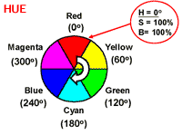
(cont.) HSB Model
Hue - color reflected from or transmitted through an object, measured on color wheel

Slide 46
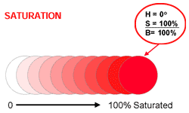
(cont.) HSB Model
Saturation (or chroma) - strength or purity of color (% of grey in proportion to hue)

Slide 47
(cont.) HSB Model
Brightness - relative lightness or darkness of color, also measured as %
0%
50%
100%
Black |  |  |  |  |  |  |  |  | white

Slide 48
Color Palettes
Palettes are mathematical tables that define the color of pixels displayed on the screen.
Palettes are called ‘color lookup tables’ or CLUTs on Macintosh.
Most common palettes are
1 bit (black an white),
4 bit (16 colors),
8 bit (256 colors),
16 bit (65,536 colors ; for color images),
and 24-bit deep (16, 777,216; totally photo-realistic).

Slide 49
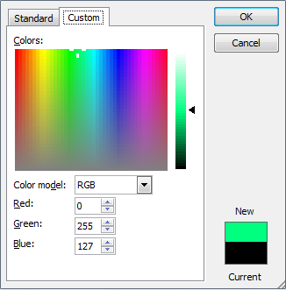
(cont.) Color Palettes

Slide 50
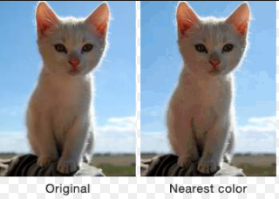
(cont) Color Paletes
Dithering:
a process whereby the color value of each pixel is changed to the closest matching color value in the target palette.
Done by using a mathematical algorithm.
Dithering software is usually built into image-editing software and available in many multimedia authoring systems

Slide 51
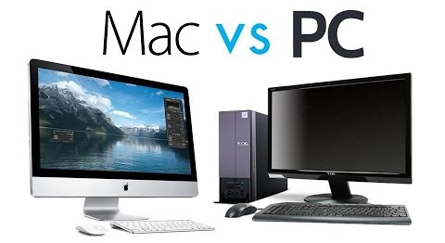
Image File Type Used in Multimedia
Macintosh formats. – PICT
Windows formats. – DIB,BMP, RIFF
Cross-platform formats. – JPEG,GIF,DXF

Slide 52
Macintosh Formats
On the Macintosh, the most commonly used format is PICT.
PICT is a complicated and versatile format developed by Apple.
Almost every image application on the Macintosh can import or export PICT files.
In a PICT file, both vector-drawn objects and bitmaps can reside side-by-side.

Slide 53
Windows Formats
The most commonly used image file format on Windows is DIB (device-independent bitmap).
The preferred file type for multimedia developers in Windows is Resource Interchange File Format (RIFF).
Bitmap formats used most often by Windows developers are:
BMP - A Windows bitmap file.
TIFF (Tagged Interchange File Format) - Extensively used in DTP packages.
PCX - Used by MS-DOS paint software.

Slide 54
Cross-Platform Formats
The image file formats that are compatible across platforms are:
JPEG, GIF, and PNG – Most commonly used format on the Web
Adobe PDF (Portable Document Format) – Manages multimedia content
PSD, AI, CDR, DXF – Proprietary formats used by applications
Initial Graphics Exchange Standard (IGS or IGES) –Standard for transferring CAD drawings
*JPEG and GIF (Joint Photographic Experts Group) – (Graphics Interchange )Format

Slide 55
Summary
The computer generates still images as bitmaps and vector-drawn images.
Images can be incorporated in multimedia using clip arts, bitmap software, or by capturing, editing, or scanning images.
Creating 3-D images involves modeling, extruding, lathing, shading, and rendering.
Color is one of the most vital components of multimedia.

