Slide 1
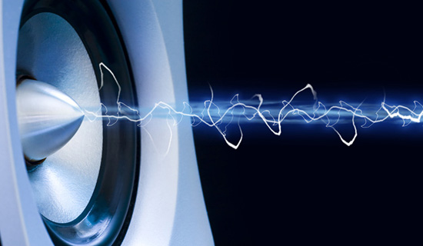
TOPIC 5 - SOUND
Arranged by :
MOHD SAIFULNIZAM ABU BAKAR
saiful.uitm.edu.my

Slide 2
Overview
Introduction to sound.
Multimedia system sound.
Digital audio.
MIDI audio.
Audio file formats.
MIDI versus digital audio.
Adding sound to multimedia project.
Professional sound.
Production tips.

Slide 3
Introduction to Sound
Sound is the best way to attract attention.
Often audio provides the only effective way to convey an idea, elicit an emotion, or dramatize point.
Sounds also can be combined in a multimedia presentation to provide information and enhance the other media being presented.

Slide 4
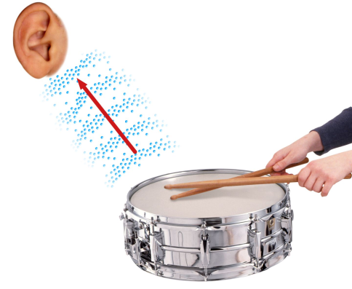
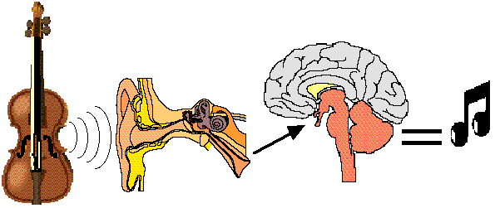
(cont.) Introduction to sound
How is sound produced
Vibrations in the air create waves of pressure that are perceived as sound. These vibrations are passed on from one air molecule to another and eventually reach our ears. Our ears then relay the vibrations to out brain, which processes them, and thus we hear sound.

Slide 5
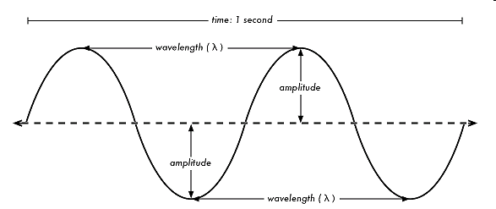
(cont.) Introduction to Sound
Sound waves vary in sound pressure level (amplitude) and in frequency or pitch.
‘Acoustics’ is the branch of physics that studies sound.
Sound pressure levels (loudness or volume) are measured in decibels (dB).

Slide 7
Why sound important
To set the mood
To catch the interest of the audience
To alert the audience
To include narration: effective for training and educational application.

Slide 8
Multimedia System Sound
System sounds are assigned to various system events such as startup and warnings, among others.
Macintosh provides several system sound options such as glass, indigo, laugh.
In Windows, available system sounds include start.wav, chimes.wav, and chord.wav.
Multimedia sound is either digitally recorded audio or MIDI (Musical Instrumental Digital Interface) music.

Slide 9
Multimedia sound is either digitally recorded audio or MIDI (Musical Instrumental Digital Interface) music.
Sound
Digital Audio
MIDI

Slide 10
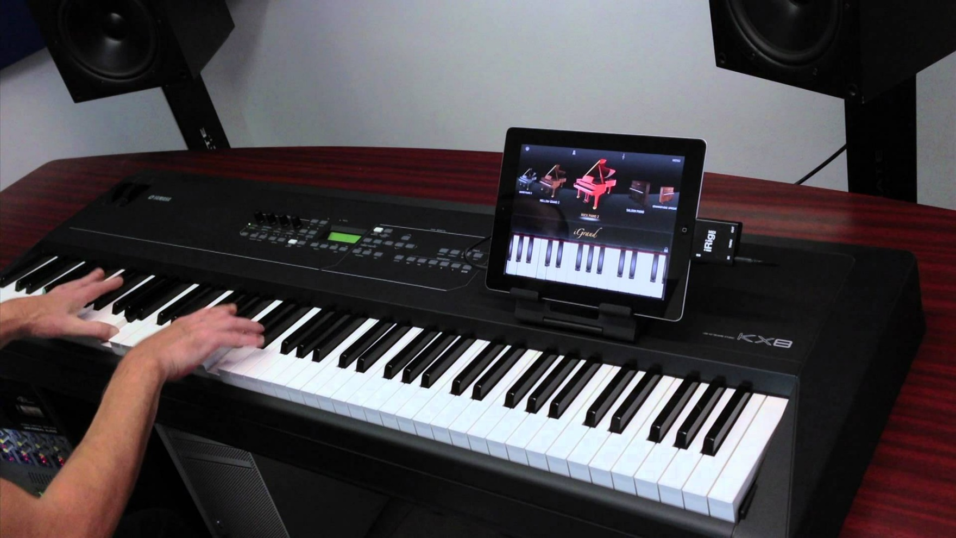
Recording Digital / MIDI
https://www.youtube.com/watch?v=oeHrtSVcm0s

Slide 11
Digital Audio
Digital audio data is the actual representation of sound, stored in the form of samples.
Samples represent the amplitude (or loudness) of sound at a discrete point in time.
Quality of digital recording depends on the
sampling rate(or frequency), that is, the number of samples taken per second. It is measured in kilohertz means thousands of samples per second. Example : 22kHz
sample size (resolution / bit depth / dynamic range),that is how many numbers are used to represent the value of each sample. Example : 16 bits

Slide 12
The three sampling frequencies most often used in multimedia are CD-quality 44.1 kHz, 22.05 kHz and 11.025 kHz.

Slide 13
(cont.) Digital Audio
The number of bits used to describe the amplitude of sound wave when sampled, determines the sample size.
Digital audio is device independent.
The value of each sample is rounded off to the nearest integer (quantization).
Crucial aspects of preparing digital audio files are:
Balancing the need for sound quality against available RAM and hard disk resource.
Setting appropriate recording levels to get a high-quality and clean recording.

Slide 14
(cont.) Digital Audio
Audio resolution determines the accuracy with which sound can be digitized.
Size of a monophonic digital recording = sampling rate x duration of recording in seconds x (bit resolution/8) x 1.
Size of stereo recording = sampling rate x duration of recording in seconds x (bit resolution/8) x 2.
Once a recording had been completed, it almost always needs to be edited.
Audacity – an open source, cross platform editing tool for digitizing sound. (http://audacity.sourceforge.net).

Slide 15
Monophonic
Commonly called mono sound, mono or non-stereo sound, this early sound system used a single channel of audio for sound output.
Monophonic sound is the most basic format of sound output.
Mono (monophonic, or monaural) is sound from a single source.
All speakers in a mono system (like an intercom) will carry the same signal.

Slide 16
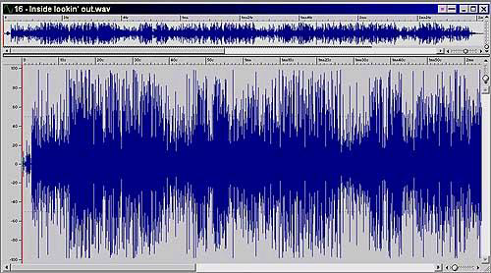
Example of Monophonic

Slide 17
Stereophonic
Commonly called stereo sound or just stereo
Stereophonic sound divides sounds across two channels (recorded on two separate sources) then the recorded sounds are mixed so that some elements are channelled to the left and others to the right.
Stereo (stereophonic) is sound from two sources, ideally spaced apart, and reproduces sound the way we hear it naturally, with two ears.

Slide 18
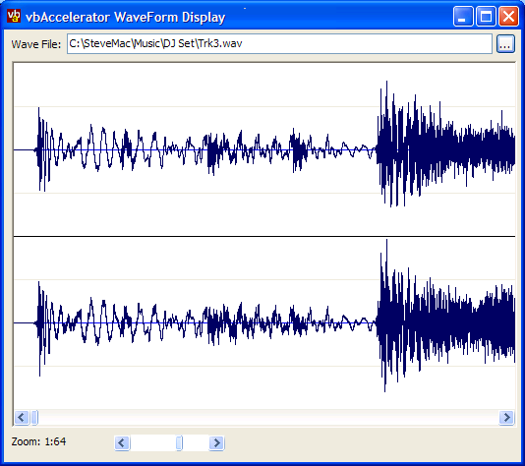
Example of Stereophonic

Slide 19
Basic Sound Editing
Basic sound editing operations include:
Trimming- removing the ‘dead air’ or blank space from the front of a recording and any unnecessary extra time off the end is your first sound editing task (using mouse cursor and menu command such as cut, clear, erase or silence)
splicing and assembly- using the same tools mentioned in trimming, which will probably want to remove the extraneous noises that inevitably creep into a recording.

Slide 20
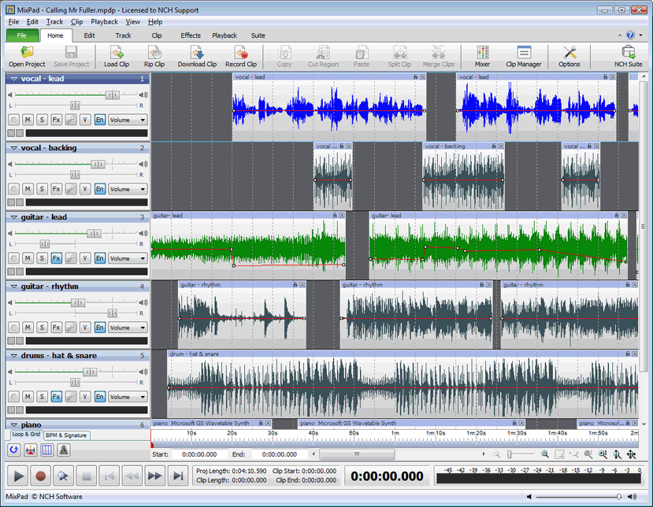
Basic Sound Editing
volume adjustments- select all the data in the file, and raise or lower the overall volume by certain amount.
working on multiple tracks - being able to edit and combine multiple tracks (for sound effects, voice-over, music, etc.) and then merge the tracks and export them in a ‘final mix’ to a single audio file is important.

Slide 21
Additional Sound Editing
Additional available sound editing operations include:
format conversion- in some case, your digital audio editing software might read a format different from that read by your presentation or authoring program.
resampling or downsampling- if you recorded and edited your sounds at 16-bit sampling rates but are using lower rates and resolutions, you must resample or downsample the file.
fade-ins and fade-outs- to smooth out the very beginning and the very end of a sound file.
Equalization – some programs offer digital equalization (EQ) capabilities that allow you to modify a recording’s frequency content so that it sounds brighter or darker.

Slide 22
(cont.) Digital Audio
time stretching- advanced programs let you alter the length (in time) of a sound file without changing its pitch.
digital signal processing (DSP) – some programs allow you to process the signal with reverberation, multitap delay, chorus, flange, and other special effects using digital signal processing (DSP) routines.
reversing sounds- reverse all or a portion of a digital audio recording (played backward).

Slide 23
MIDI Audio
MIDI is a shorthand representation of music stored in numeric form.
It is not digitized sound.
A sequencer software and sound synthesizer is required in order to create MIDI scores.
MIDI is device dependent.

Slide 24
MIDI Audio
Since they are small, MIDI files embedded in web pages load and play promptly.
Length of a MIDI file can be changed without affecting the pitch of the music or degrading audio quality.
Working with MIDI requires knowledge of music theory.

Slide 25
AUDIO File Formats
A sound file’s format is a recognized methodology for organizing data bits of digitized sound into a data file.
On the Macintosh, digitized sounds may be stored as data files, resources, or applications such as AIFF or AIFC.
In Windows, digitized sounds are usually stored as WAV files.
CD-ROM/XA (Extended Architecture) format enabled several recording sessions to be placed on a single CD-R (recordable) disc.
Linear Pulse Code Modulation is used for Red Book Audio data files on consumer-grade music CDs.

Slide 26
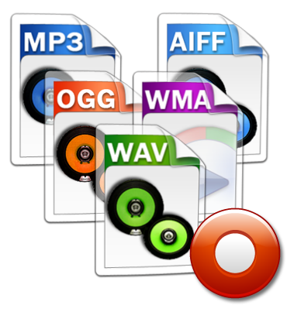
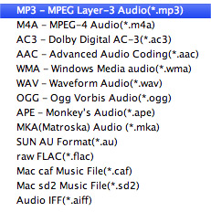
Audio Format

Slide 27
MIDI vs Digital Audio
MIDI is analogous to structured or vector graphics, while digitized audio is analogous to bitmapped images.
MIDI is device dependent while digitized audio is device independent.
MIDI files are much smaller than digitized audio.
MIDI files sound better than digital audio files when played on a high-quality MIDI device.

Slide 28
(cont.) MIDI vs Digital Audio
With MIDI, it is difficult to playback spoken dialog, while digitized audio can do so with ease.
MIDI does not have consistent playback quality while digital audio provides consistent playback quality.
One requires knowledge of music theory in order to run MIDI, while digital audio does not have this requirement.

Slide 29
Comparison
 | Digital Audio | MIDI
Device? | Device independent | device dependent
File Size | Big | Small
Website Load | Slow | Load and play quickly
Sound Quality | - | Better (high quality)
Playback Spoken Dialog | can do so with ease. | difficult
Playback Quality. | consistent | Not consistent
Knowledge In Music Theory | no | YES

Slide 30
Adding Sound to Multimedia Project
File formats compatible with multimedia authoring software being used along with delivery mediums, must be determined.
Sound playback capabilities offered by end user’s system must be studied.
The type of sound, whether background music, special sound effects, or spoken dialog, must be decided.
Digital audio or MIDI data should be selected on the basis of the location and time of use.

Slide 31
Professional Sound
Red Book (or ISO 10149) standard is a standard for digitally encoding high-quality stereo.
For this standard, the digital audio sample size is 16 bits and sampling rate is 44.1 KHz.
The amount of digital sound information required for high-quality sound takes up a great deal of disk storage space.
Compression techniques reduce space but reliability suffers.
Space can be conserved by downsampling or reducing the number of sample slices taken per second.
File size of digital recording (in bytes) = sampling rate X duration of recording (in secs) X (bit resolution/8) X number of tracks.

Slide 32
Production Tips
Recording on inexpensive media rather than directly to disk prevents the hard disk from being overloaded with unnecessary data.
The equipment and standards used for the project must be in accordance with the requirements.
It is vital to maintain a high-quality database that stores the original sound material.
Sound and image synchronization must be tested at regular intervals.

Slide 33
(cont.) Production Tips
The speed at which most animations and computer-based videos play, depends on the user’s CPU.
Sound’s RAM requirements as well as the users’ playback setup must be evaluated.
Copyrighted material should not be recorded or used without securing appropriate rights from owner or publisher.

Slide 34
Summary
MIDI is a shorthand representation of music stored in numeric form.
Digital audio provides consistent playback quality.
MIDI files are much smaller than digitized audio.
MIDI files sound better than digital audio files when played on high-quality MIDI device.

Slide 35
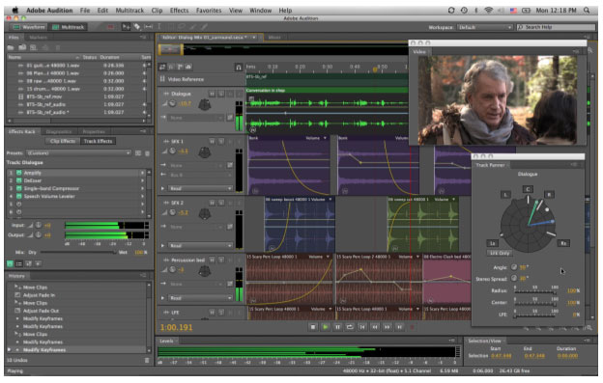
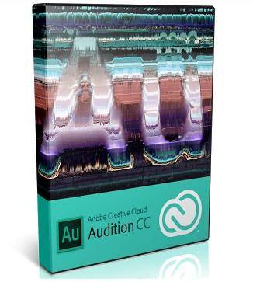
Adobe Audition

Slide 36
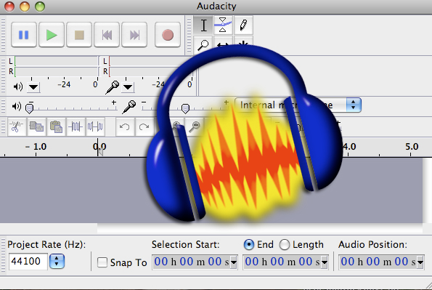
Audacity

Slide 37
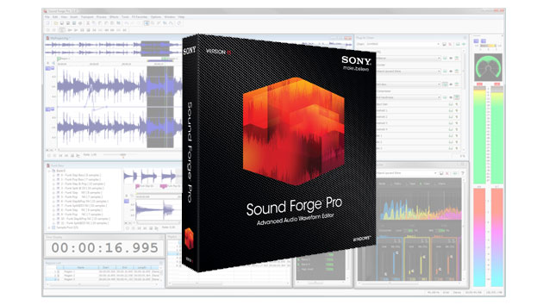
Sony Sound Forge

Slide 38
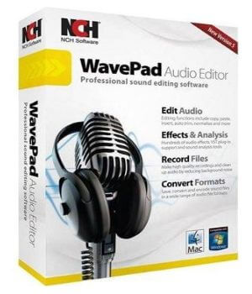
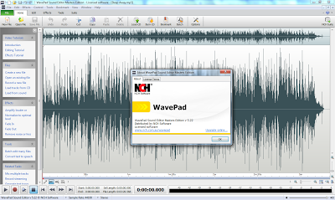
WavePad Master's Edition

