Slide 1
TOPIC 6 - VIDEO
Arranged by :
MOHD SAIFULNIZAM ABU BAKAR
saiful.uitm.edu.my

Slide 2
Overview
Using video.
Digitizing the video signal
How video works?
Video compressions and file formats
Broadcast video standards.
Analog video.
Digital video.
Video recording and tape formats.
Shooting and editing video.
Optimizing video files for CD-ROM.

Slide 3
Using video
Video is an excellent tool for delivering multimedia.
Video places the highest performance demand on computer and its memory and storage.
Digital video has replaced analog as the method of choice for making and delivering video for multimedia.

Slide 4
(cont.) Using video
Digital video device produces excellent finished products at a fraction of the cost of analog.
Digital video eliminates the image-degrading analog-to-digital conversion.
Many digital video sources exist, but getting the rights can be difficult, time-consuming, and expensive.

Slide 5
Digitizing the video signal
Analogue video is essentially a product of the television industry and therefore conforms to television standards.
Digital video is a product of the computing industry and therefore conforms to digital data standards.
Is usually recorded and played as an analog signal.
It must therefore be digitized in order to be incorporated into a multimedia title.

Slide 6
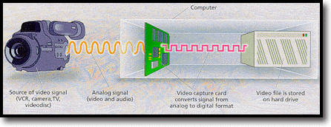
(cont.) Digitizing the video signal

Slide 7
How video works
Light reflected from an object through the camera’s lens is converted into electronic signal by charge-coupled device (CCD).
This electronic signal contains three channels of color information and synchronization pulses (sync).
Several video standards exist that deal with the amount of separation between the components of the signal.

Slide 8
How video works
How Video Works (continued)
Analog video transfer methods
Component video separates color and brightness over three cables.
S-video separates color and brightness over two wires.
Composite video transmits the whole video signal in a single cable.

Slide 9
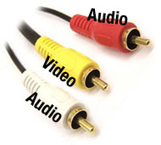

Slide 10
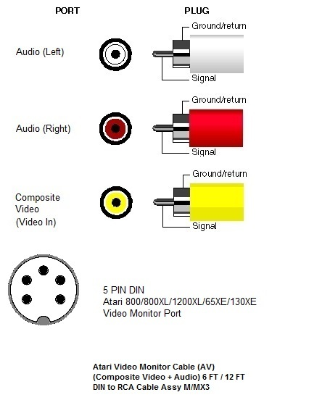
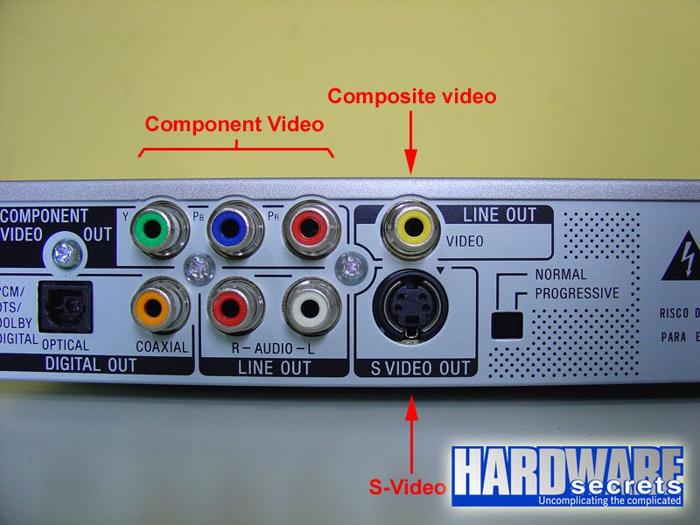

Slide 11
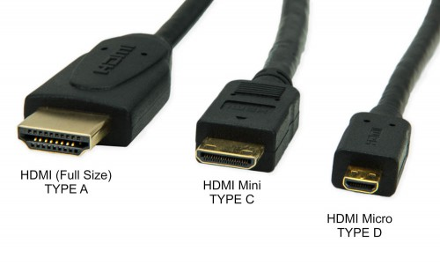
New Cable
High-Definition Multimedia Interface (HDMI) connector for purely digital input.

Slide 12
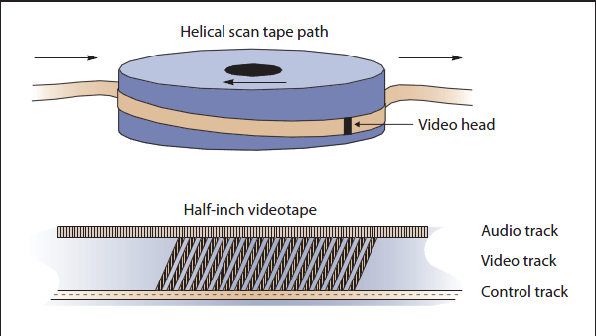
How video works
How Video Works (continued)
Analog video
Video is recorded onto magnetic tapes.
Video frames are interlaced.

Slide 13
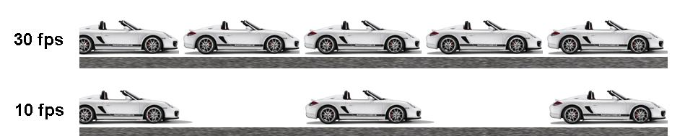
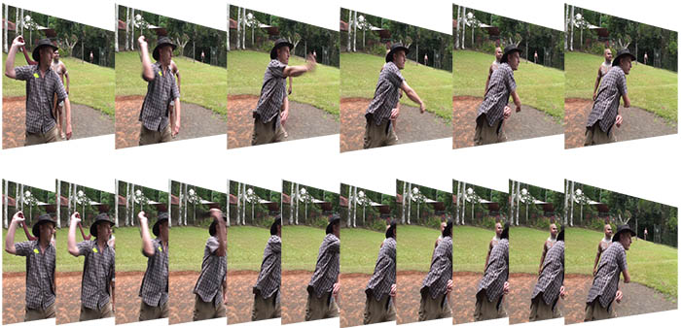
Frames per second (fps)

Slide 14
Video compression
Because of the large sizes associated with video files, video compression/decompression programs, known as codecs, have been developed.
These programs can substantially reduce the size of video files, which means that more video can fit on a single CD and that the speed of transferring video from a CD to the computer can be increased.

Slide 15
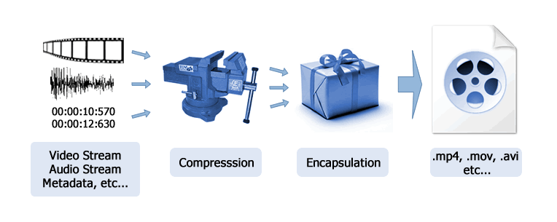
Video compression

Slide 16
Video file formats
Motion Pictures Expert Group (.mpg)
Quicktime (.mov)
Audio Video Interleaved(.avi)
Windows Media Video (.wmv)
Adobe Flash video (.flv)

Slide 17
Analog Broadcast Video Standards
Three analog Broadcast Video Standards :
National Television Standards Committee (NTSC)
Phase Alternate Line (PAL)
Sequential Color and Memory (SECAM)

Slide 18
(cont.) Broadcast Video Standards
National Television Standards Committee (NTSC):
These standards define a method for encoding information into electronic signal that creates a television picture.
It has screen resolution of 525 horizontal scan lines and a scan rate of 30 frames per second.
Used in United states, Canada, Mexico and Japan

Slide 19
(cont.) Broadcast Video Standards
Phase Alternate Line (PAL):
PAL has a screen resolution of 625 horizontal lines and a scan rate of 25 frames per second.
Used in United Kingdom, Western Europe, Australia, South Africa, China and South America.

Slide 20
(cont.) Broadcast Video Standards
Sequential Color and Memory (SECAM):
SECAM has a screen resolution of 625 horizontal lines and is a 50 Hz system.
SECAM differs from NTSC and PAL color systems in its basic technology and broadcast method.
Used in France, Eastern Europe and few other countries

Slide 21
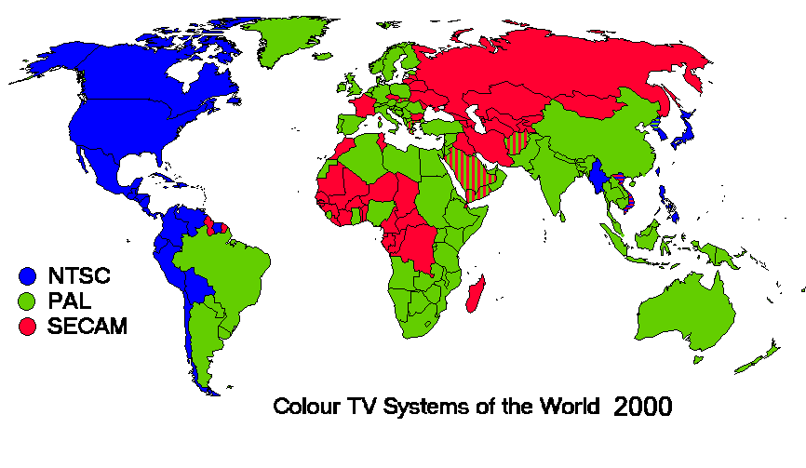

Slide 22
 | NTSC | PAL | SECAM
Screen Resolution | 525 | 625 | 625
Scan Rate | 30 fps | 25 fps | 50 Hz

Slide 23
(cont.) Broadcast Video Standards
Advanced Television Systems Committee (ATSC) for Digital Television (DTV):
This digital standard provides TV stations with sufficient bandwidth to present four or five Standard Television (STV) signals or one High Definition TV (HDTV) signal.
This standard allows for transmission of data to computers and for new Advanced TV (ATV) interactive services.

Slide 24
Analog Video
Overscan and the safe title area:
Analog television sets remain the most widely installed platforms for delivering and viewing video.
Overscan occurs when an image is larger than the standard TV screen.
Underscan occurs when computer monitors display a smaller image on picture tube.
The safe title area is where the image will not be affected by overscanning, even in the worst conditions.

Slide 25
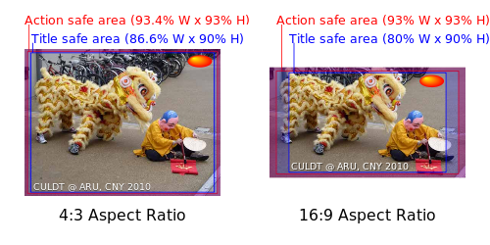

Slide 26
TV Safe Title Area

Slide 27
(cont.) Analog Video
Interlacing effects:
In television, the electron beam makes two passes on the screen while drawing a single video frame.
It first lays down all the odd-numbered lines, and then all the even-numbered lines, hence they are interlaced.
While capturing images from a video signal, they can be filtered through a de-interlacing filter provided by image-editing applications.

Slide 28
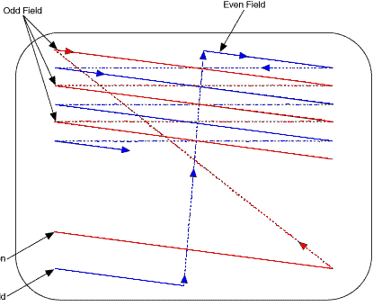
Interlacing effects

Slide 29
(cont.) Analog Video
Text and titles for television and taking care of analog tapes:
Titles for video productions can be created with an analog character generator.
Computers can create titles digitally using video and image-editing software.
New tapes should always be fast-forwarded to the end and then rewound, to ensure even tape tension.
Font for titles should be plain, san serif and bold enough to be easily understood.
Do not kern tightly
When dealing with dark background, use white or light color for text.

Slide 30
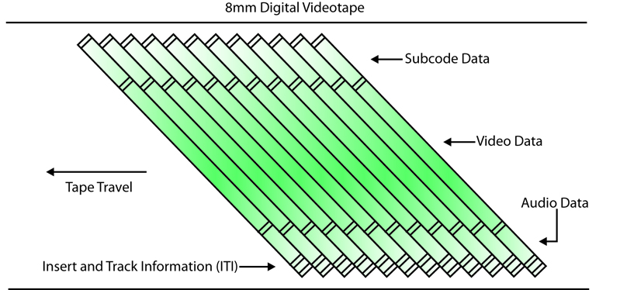
How Video Works (continued)
Digital video
The output is digitized by the camera into a sequence of single frames.
The video and audio data are compressed before being written to a tape or digitally stored.

Slide 31
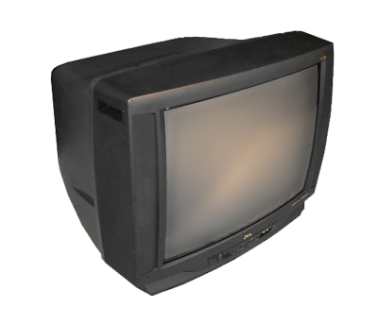
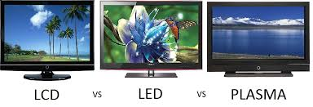
How Video Works (continued)
CRT and LCD displays
Interlacing and progressive scan technologies
Most computer video output is greater than 1024 x 768.

Slide 32
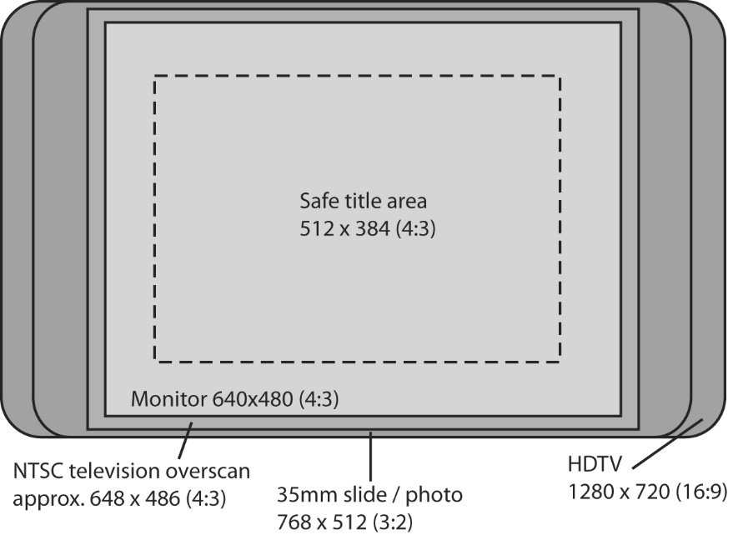
Digital Video
How Video Works (continued)
Digital video (continued)
Multiple HDTV formats exist.
Resolutions and frame rates vary.
The aspect ratio of HDTV is 16:9.

Slide 33
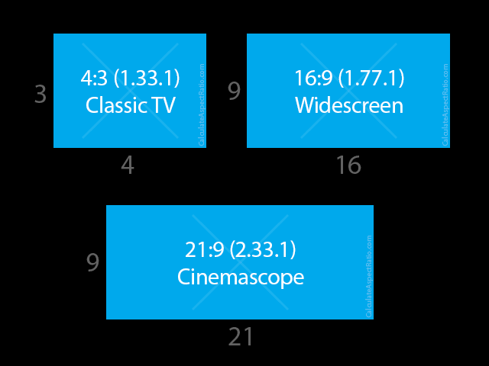

Slide 34
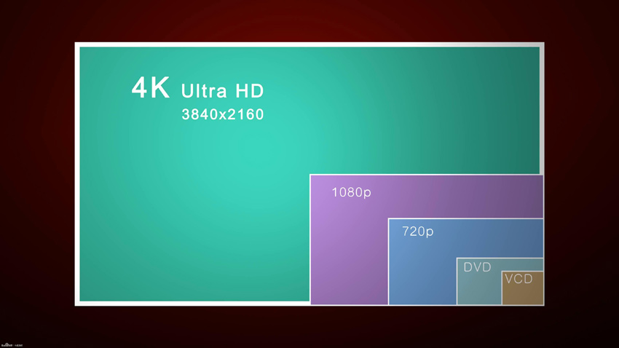
Digital Video Resolution

Slide 35
Digital Video
Video clip stored on any mass-storage device can be played back on a computer’s monitor without special hardware.
Setting up a production environment for making digital video, requires some hardware specifications.
Some specifications include computer with FireWire connection and cables, fast processor, plenty of RAM, fast and big hard disk.

Slide 36
(cont.) Digital Video
Digital video architecture.
Digital video compression.

Slide 37
Digital Video architecture
Digital video architecture consists of a format for encoding and playing back video files by a computer.
Architecture includes a player that can recognize and play files created for that format.

Slide 38
Digital Video compression
Digital video compression schemes or CODECS is the algorithm used to compress (code) a video for delivery.
The codec then decodes the compressed video in real-time for fast playback.
Streaming audio and video starts playback as soon as enough data has transferred to the user’s computer to sustain this playback.

Slide 39
(cont.) Digital Video compression
Codecs such as Theora and H.264 compress digital video information at rates that range from 50:1 to 200:1.

Slide 40
(cont.) Digital Video compression
MPEG is a real-time video compression algorithm. [Moving Picture Experts Group]
MPEG-4 includes numerous multimedia capabilities and is a preferred standard.
MPEG-7 (or Multimedia Content Description Interface) integrates information about motion video elements with their use.

Slide 41
Digital Video Containers
Video format converters
Produce more than one version of your video to ensure that video will play on all the devices and in all the browsers necessary for your project’s distribution.

Slide 42
Shooting and Editing Video
Import video and sound at the highest resolution and with the least amount of compression possible.
Resolution should be reduced and footage must be compressed later according to the requirements.

Slide 43
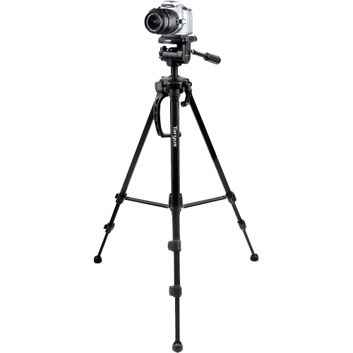
Shooting and Editing Video
Shooting platform
A steady shooting platform should always be used.
Use an external microphone.
Know the features of your camera and software.
Decide on the aspect ratio up front.

Slide 44
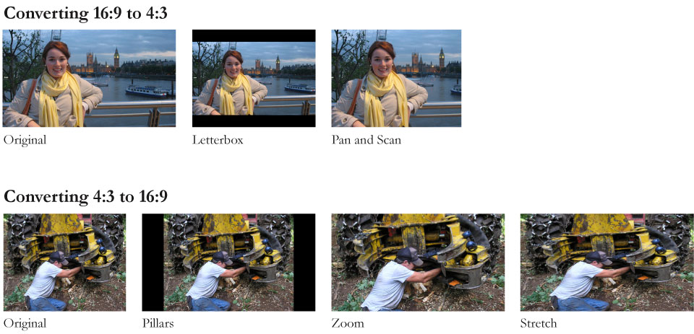
Shooting and Editing Video (continued)

Slide 45
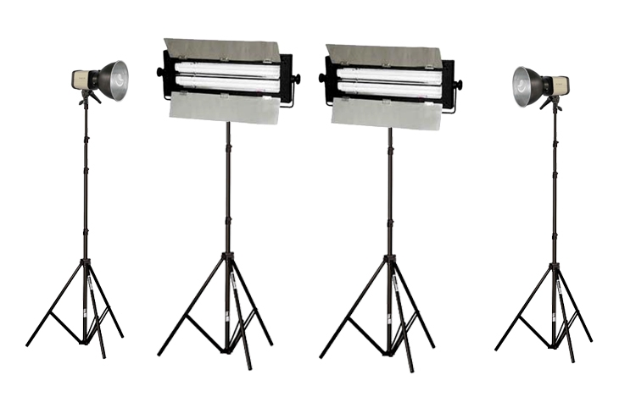
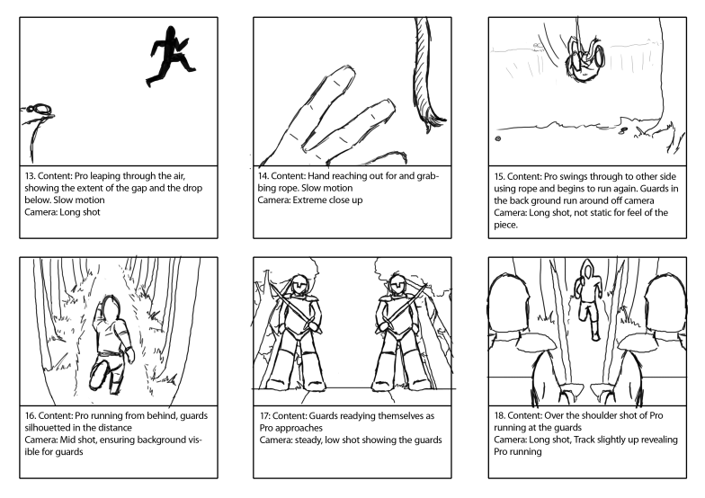
Shooting and Editing Video (continued)
Storyboarding
Successful video production requires planning.
Lighting
Always strive for adequate lighting.

Slide 46
Shooting and Editing Video (continued)
Composition
Consider the delivery medium when composing shots.
Use close-up and medium shots when possible.
Move the subject, not the lens.
Beware of backlighting.
Adjust the white balance.

Slide 47
Shooting and Editing Video (continued)
Titles and text (continued)
Use plain, sans serif fonts that are easy to read.
Choose colors wisely.
Provide ample space.
Leave titles on screen long enough so that they can be read.
Keep it simple.

Slide 48
Shooting and Editing Video (continued)
Titles and text (continued)

Slide 49
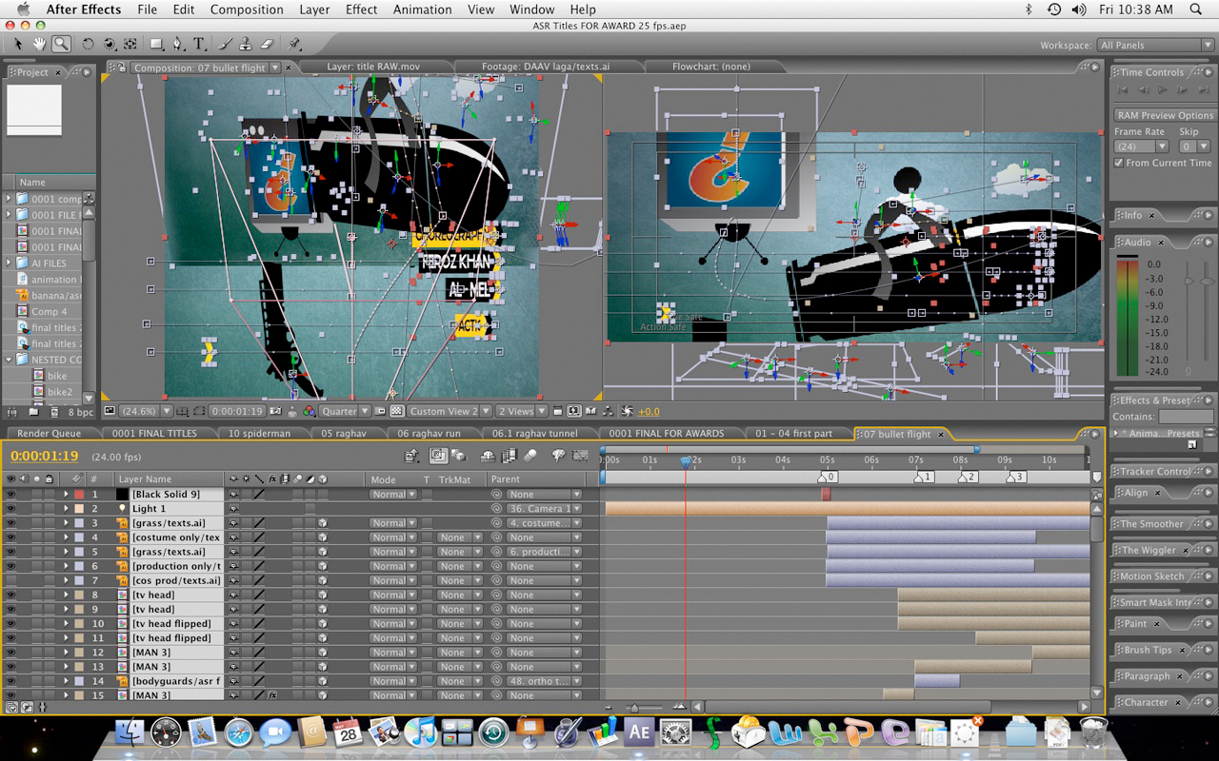
Shooting and Editing Video (continued)
Titles and text (continued)

Slide 50
Shooting and Editing Video (continued)
Nonlinear editing
High-end software has a steep learning curve.
Adobe’s Premiere, Apple’s Final Cut, Avid’s Media Composer
Simple editing software is free with the operating system.
Microsoft’s Windows Live Movie Maker, Apple’s iMovie.
Remember video codecs are lossy; avoid re-editing.

Slide 51
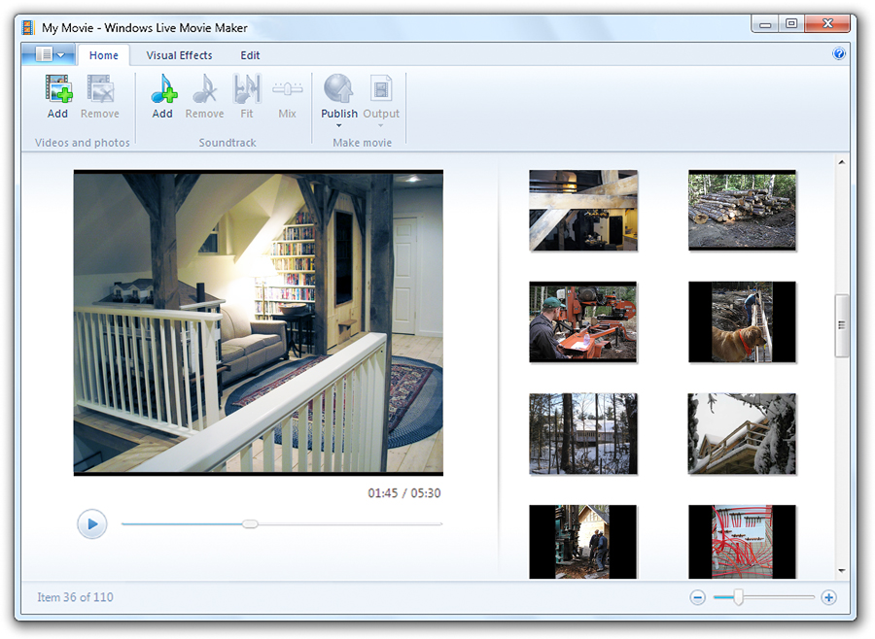
Shooting and Editing Video (continued)
Nonlinear editing (continued)

Slide 52
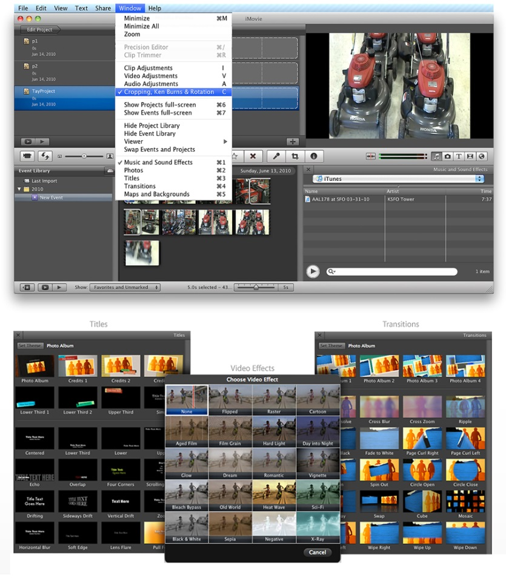
Shooting and Editing Video (continued)
Nonlinear editing (continued)

Slide 53
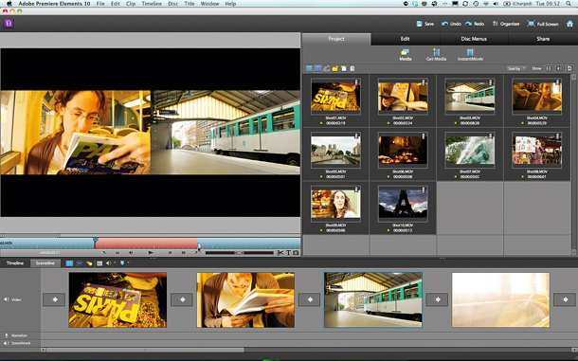
Shooting and Editing Video (continued)
Wide panoramic shots and camera motion should be avoided when shooting for a small computer window on CD-ROM or the Web.

Slide 54
Shooting and Editing Video (continued)
Chroma keys
blue screen, green screen, Ultimatte or chroma key editing is used to superimpose subjects over different backgrounds.

Slide 55
Optimizing Video Files for CD-ROM
CD-ROMs provide an excellent distribution medium for computer-based video.
When preparing video for CD-ROM distribution, interleave the audio track(s) with the video track. (flattening)
Key frames should be used every 10 to 15 frames and the size of the video window must be kept small.
The Sorenson codec is optimized for CD-ROM playback.

Slide 56
Summary
Digital video method is used for making and delivering video for multimedia.
Charge-coupled device (CCD) converts the light that has been reflected from an object through the camera’s lens.
Various video standards are NTSC, PAL, SECAM, and ATSC DTV.
Categories of video standards are composite analog, component analog, composite digital, and component digital.

