Slide 1
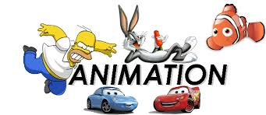
TOPIC 7 - ANIMATION
Arranged by :
MOHD SAIFULNIZAM ABU BAKAR
saiful.uitm.edu.my

Slide 2
Overview
Introduction to animation.
Computer-generated animation.
File formats used in animation.
Making successful animations.

Slide 3
Introduction to Animation
Animation is defined as the act of making something come alive.
It is concerned with the visual or aesthetic aspect of the project.
Animation is an object moving across or into or out of the screen.

Slide 4
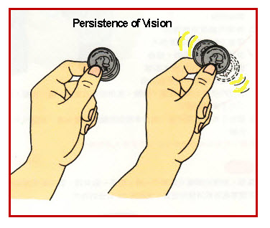
Introduction to Animation
Animation is possible because of a biological phenomenon known as persistence of vision and psychological phenomenon called phi.
In animation, a series of images are rapidly changed to create an illusion of movement.

Slide 5
(cont.) Introduction to Animation
a car driving along a line
a spinning globe of the earth

Slide 6
Computer-Generated Animation
Animation space.
2-D space
2-1/2D space
3-D space
Animation techniques.

Slide 7
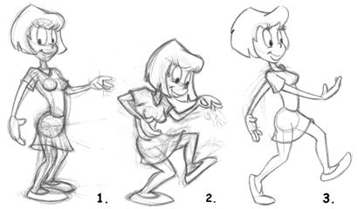
Animation Space
Animation can be rendered in:
2-D space
2-D animations are very simple and static, not changing position on the screen.
Occur on flat Cartesian x and y axes of the screen.
Using authoring and presentation software (flash, PowerPoint)

Slide 8
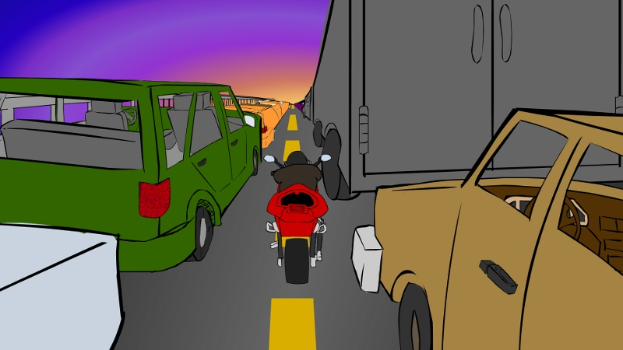
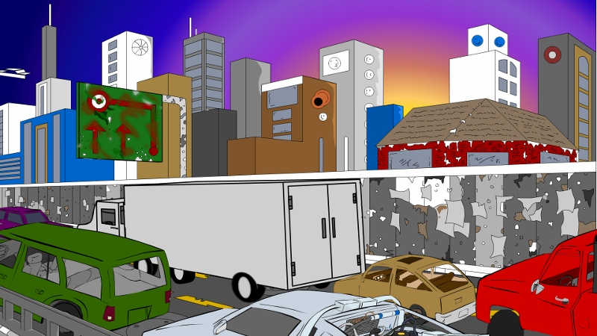
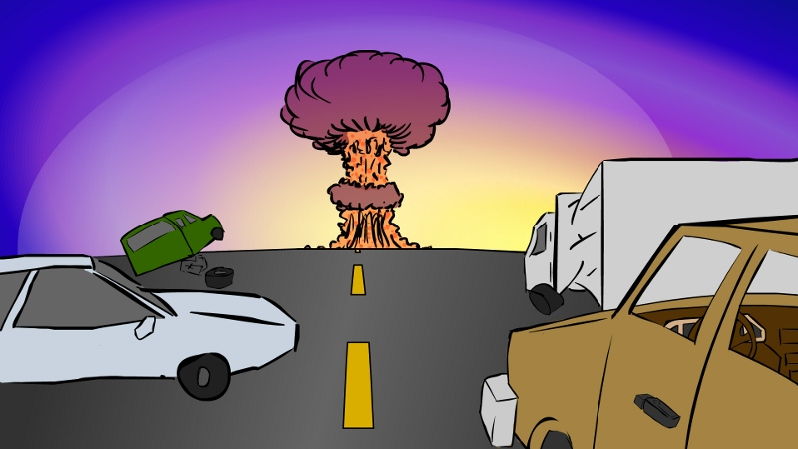
(cont.) Animation Space
Example 2 D animation
Traditional (classic) animation is the oldest and historically the most popular form of animation.
Specifically designed to teach students fundamental skills.
Students will develop their drawing skills in terms of perspective, life drawing, gesture, story-boarding, and character development.

Slide 9
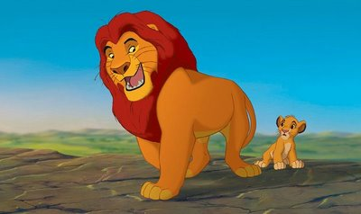
(cont.) Animation Space
2-1/2D space
An illusion of depth (the z axis) is created through shadowing, highlighting, and forced perspective, though in reality the image rests in two dimensions.

Slide 10
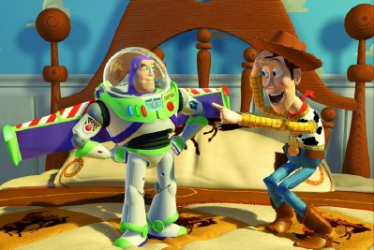
(cont.) Animation Space
3-D space
Complicated and realistic animations are done in 3-D space (x, y and z).
Allowing an image to created with front, back, sides, top, bottom, etc.
Using 3-D animation program such as NewTeks’s Lightwave or Alias|Wavefront’s Maya.

Slide 11
Animation Techniques
Animation process.
Cel animation.
Computer animation.

Slide 12
Animation Process
The steps to be followed in creating animation are:
Organize the execution in a series of logical steps.
Choose an animation tool best suited for the job.
Build and tweak the sequences.
Post-process the completed animation.

Slide 13
Cel Animation
The animation techniques a made famous by Disney (plays at 24 frames per second).
Means, one minutes require as 1440 separate frames.
Cel animation is a technique in which a series of progressively different graphics are used on each frame of movie film.
Cel animation begins with keyframes.
The term "cel" is derived from the clear celluloid sheets that were used for drawing each frame.

Slide 14
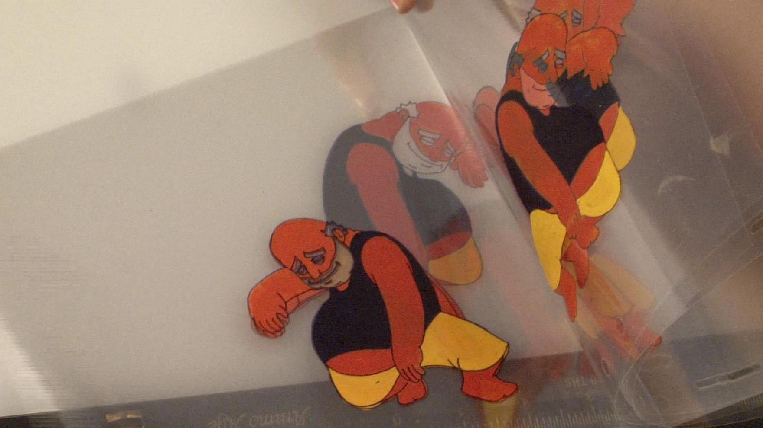
Cel Animation

Slide 15
(Cont.) Cel Animation
Begin with keyframes
Keyframes refer to the first and the last frame of an action.
The series of frames in between the keyframes are drawn in the tweening process.
Tweening depicts the action that takes place between keyframes.
Tweening is followed by the pencil test to check smoothness, continuity and timing.

Slide 16
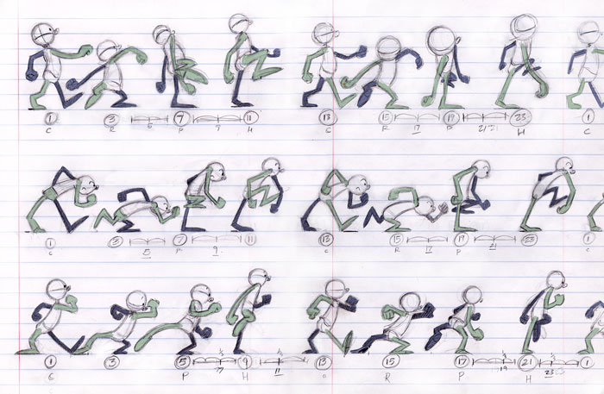
Cel Animation

Slide 17
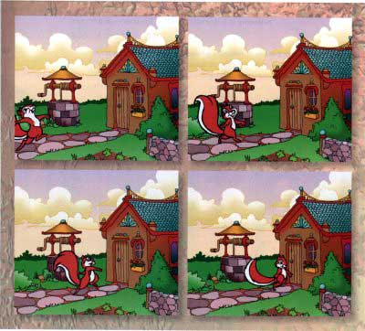
(Cont.) Cel Animation

Slide 18
Computer Animation
Computer animation is very similar to cel animation – use terms such as layer, keyframe and tweening.
The primary difference is in how much must be drawn by the animator and how much is automatically generated by the software.
In computer animation, inks refer to special methods for computing color values, providing edge detection and layering.

Slide 19
(Cont.) Computer Animation
Kinematics is the study of the movement and motion of structures that have joints, such as walking man .
Inverse kinematics is the process of linking objects, and defining their relationship and limits.
Morphing is an effect in which a still or moving image is transformed into another.

Slide 20
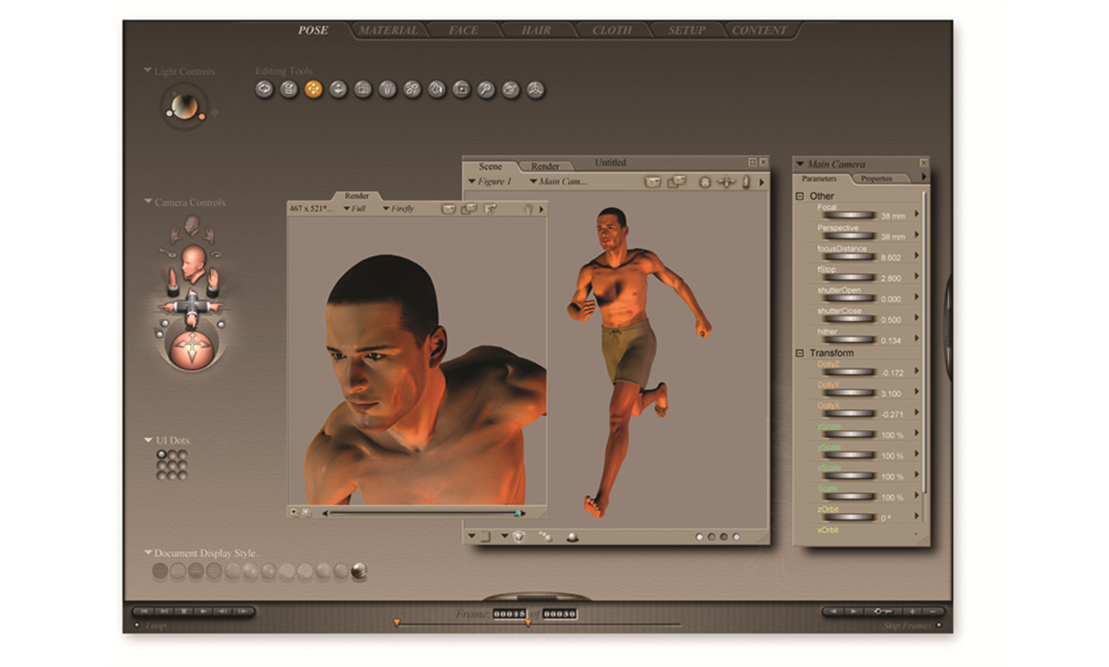

Slide 21
Morphing
Morphing effect
is the process of transforming one image into another via a series of frames
this effect can transition not only between still images but often between moving images as well
morphing technique involves
selecting sets of corresponding points on each of the images
based in these sets of points, the morphing program rearranges the pixels to transition the original image into another via a series of intervening images
Warping effect
allows you to manipulate a single image

Slide 22
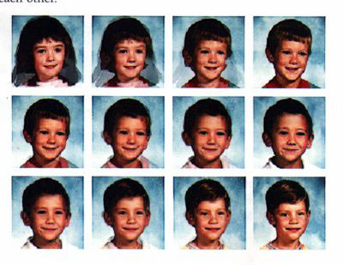
Morphing

Slide 23
Warping

Slide 24
Kinematics
Kinematics effect
kinematics is the study of the movement and motion of structures that have joints, such as walking man
kinematics technique involves
calculate the position, rotation, velocity and acceleration of all joints and articulated parts involved. e.g knees bend, hips flex, shoulders swing and the head bobs

Slide 25
3D Animation
Compared to 2-D animation
3-D animation takes entire experience of multimedia to another level
the user of a 3-D animation is participant, not a spectator
Creating 3-D animation involves three steps: modeling, animation and rendering

Slide 26
3D Animation
Modeling
is the process of creating 3-D objects and scenes
Animation
involves defining the object’s motion and how the lighting and views change during the animation
Rendering
is the final step in creating 3-D animation and involves giving objects attributes such as colours, surface textures and degrees of transparency

Slide 27
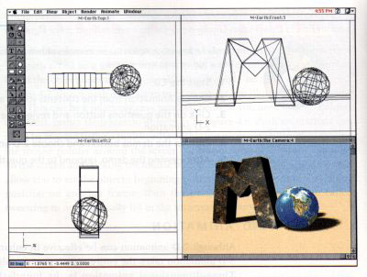
3D Animation

Slide 28
File Formats Used in Animation
.dir and .dcr - Director files.
.fli and .flc - AnimatorPro files.
.max - 3D Studio Max files.
.pics - SuperCard and Director files.
.fla and .swf - Flash files.

Slide 29
(cont.) File Formats Used in Animation
GIF89a file format:
It is a version of the GIF image format.
GIF89a allows multiple images to be put into a single file and then be displayed as an animation in the Web browser.
Applications like BoxTop Software's GIFmation or ULead's GIF Animator are needed to create GIF89a animation.

Slide 31
Making Successful Animation
Use animation carefully and sparingly.
High quality animations require superior display platforms and hardware, as well as raw computing horsepower.
File compression is very important when preparing animation files for the Web.

Slide 32
(cont.) Making Successful Animation
Some animation tools are:
Adobe’s Flash
AutoDesk’s Maya
NewTek’s Lightwave
Papervision3D
GreenSock’s TweenMax
3D Studio Max
Google Sketch Up

Slide 33
Summary
Animation is visual change over time and adds great power to multimedia.
Cell animation uses a series of progressively different graphics on each frame of movie film.
Computer animation has eased the process of creating animation.
Many file formats are designed specifically to contain animation.

