Slide 1
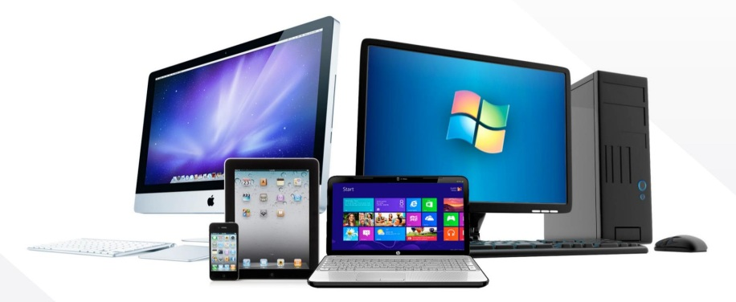
TOPIC 8 - HARDWARE
Arranged by :
MOHD SAIFULNIZAM ABU BAKAR
saiful.uitm.edu.my

Slide 2
Overview
Macintosh versus Windows platform.
Connections.
Memory and Storage devices.
Input devices.
Output devices.
Communication devices.

Slide 3

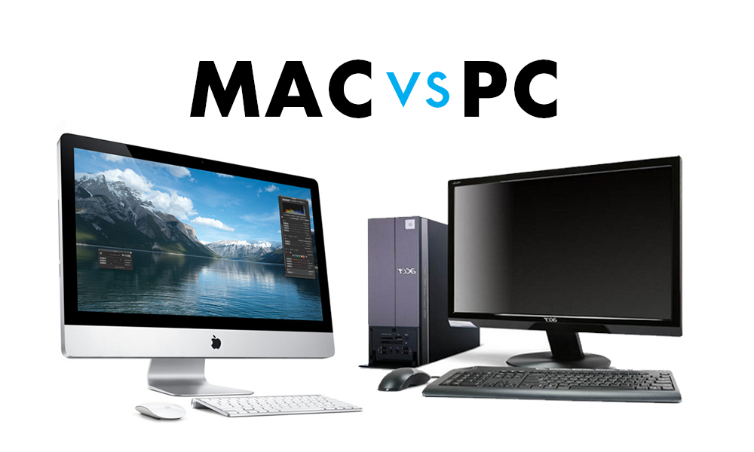
Macintosh vs Windows Platform

Slide 4
Macintosh vs Windows Platform
The Macintosh platform:
  Was launched by Apple in 1984.
  Has a good built-in audio and high-quality graphics capability.
  Includes hardware and software for digitizing and editing video and producing DVD discs.
  Makes multimedia project development easier and smoother.

Slide 5
Macintosh vs Windows Platform
The Windows platform:
  Is a collection of different vendor-neutral components that are tied together by the requirements of the Windows operating system.
  Initially focused on business computing and was not suitable for multimedia. However, it is now easier to find multimedia hardware and software for Windows as compared to the Macintosh.

Slide 6
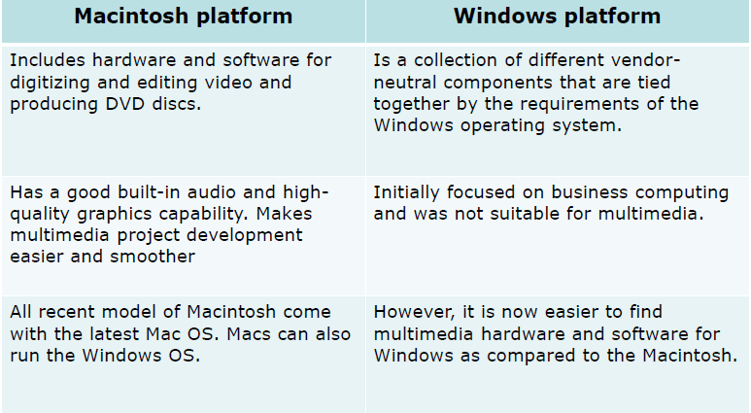
Macintosh vs Windows Platform

Slide 7
Networking Macintosh and Windows
Networking is essential for direct communication and sharing of resources across platforms.
Local area network (LAN), wide area network (WAN), and Internet connections provide connectivity and networking capabilities.

Slide 8
Networking Macintosh and Windows
In a LAN, workstations are located within a short distance. They are relatively less expensive.
In a WAN, communication systems span great distances and are typically set up and managed by large corporations. They are expensive to install and maintain.

Slide 9
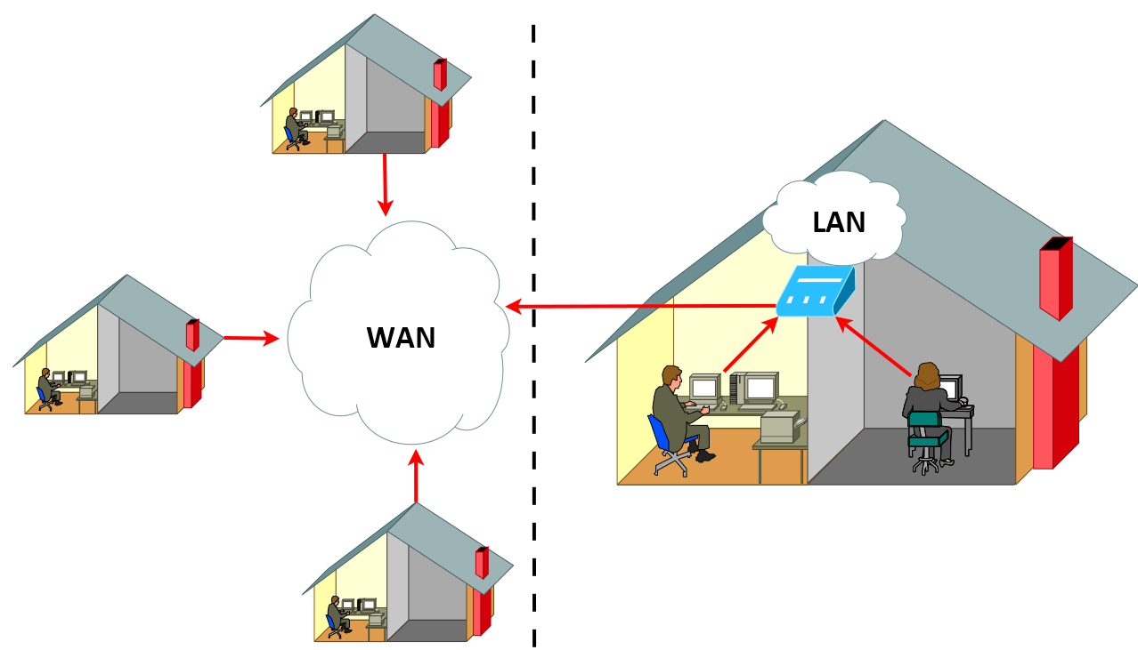
Networking Macintosh and Windows

Slide 10
(cont.) Networking Macintosh and Windows
A dial-up connection to the Internet through an Internet Service Provider (ISP) also enables communication.
To establish communication between a Macintosh and Windows PC, install Ethernet system and client-server software.
Ethernet is a method of wiring up computers.
Client/server software is required for communication and transfer of files.
Macintosh computers have built-in Ethernet networking, while Windows PCs require an additional Ethernet card.

Slide 11
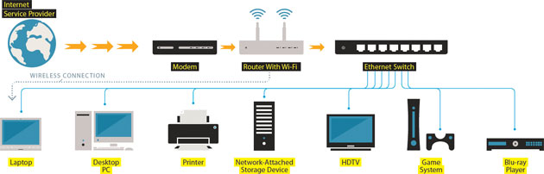
(cont.) Networking Macintosh and Windows

Slide 12
Connections
The various connection methodologies include:
  Small Computer System Interface (SCSI).
  Integrated Drive Electronics (IDE).
  Universal Serial Bus (USB).
  FireWire.

Slide 13
Small Computer System Interface (SCSI)
SCSI can connect internal and external peripheral equipments and devices that conform to the SCSI standard.
SCSI cards can be installed on Macintosh and PC platforms.
SCSI is preferred for real-time video editing, network servers, and situations that require mirroring.
SCSI ID conflicts should be avoided by providing unique IDs to devices.

Slide 14
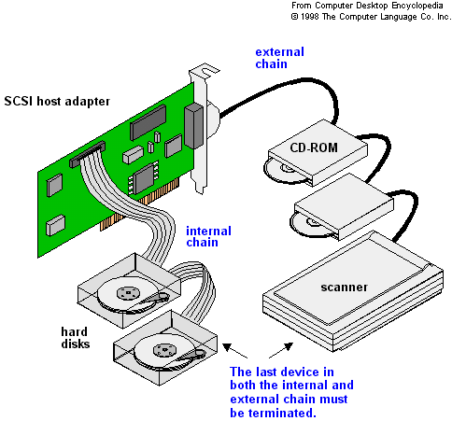
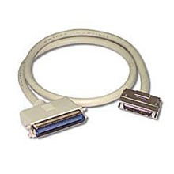
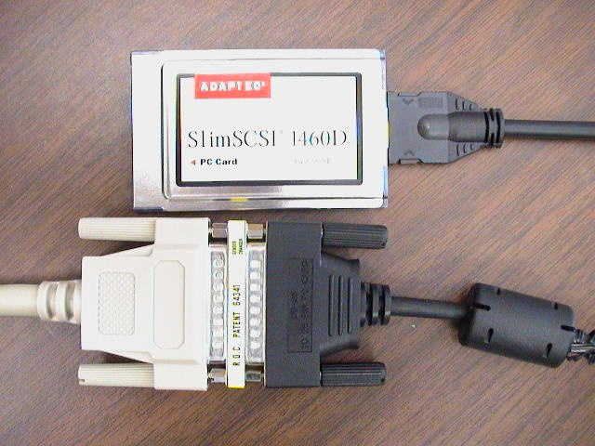
Example of SSCI

Slide 15
Integrated Drive Electronic (IDE)
IDE connections are also known as Advanced Technology Attachment (ATA).
They connect only internal peripherals.
They can connect four peripherals mounted inside the PC.
The circuitry for IDE is less expensive than SCSI.
IDE utilizes processor chip time.

Slide 16
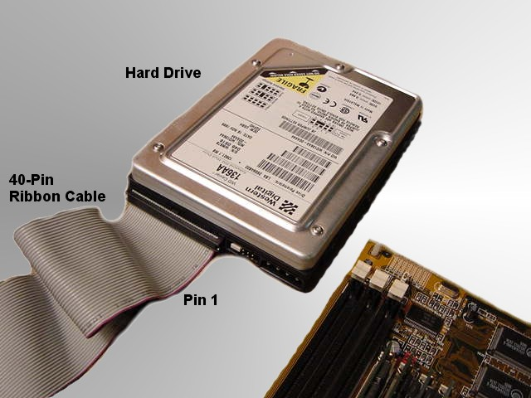
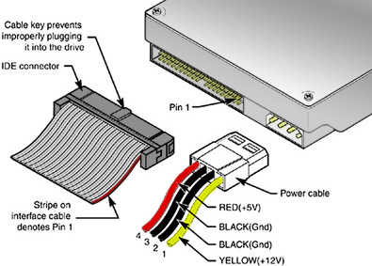
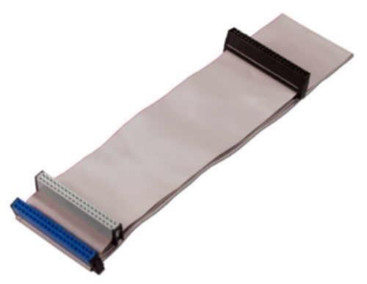
Example of IDE

Slide 17
Universal Serial Bus (USB)
It is a standard for connecting devices to the computer using the plug-and-play system.
USB uses a single cable to connect 127 USB peripherals to a single PC.
It can be attached to one computer at a time.

Slide 18
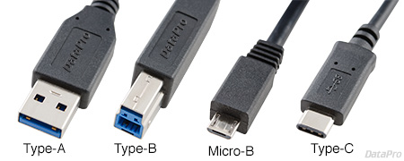
Universal Serial Bus (USB)

Slide 19
Firewire
FireWire was introduced by Apple in the 1980s.
It is the industry standard and provides support for high-bandwidth serial data transfer, particularly for digital video and mass storage.
Can connect multiple computers and peripheral devices (peer-to-peer).
It is the most common method for connecting and interconnecting professional digital video equipment.

Slide 20
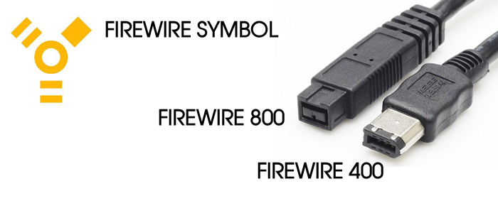
Firewire

Slide 21
Memory
Sufficient memory must be allocated for storing and archiving files.
Memory requirements of a multimedia project depend on the project's content and scope.
The two types of memory are random access memory (RAM) and read only memory (ROM).
  RAM enables the simultaneously running of many applications.
  ROM is non-volatile. The BIOS program that boots up the computer resides in the ROM.

Slide 22
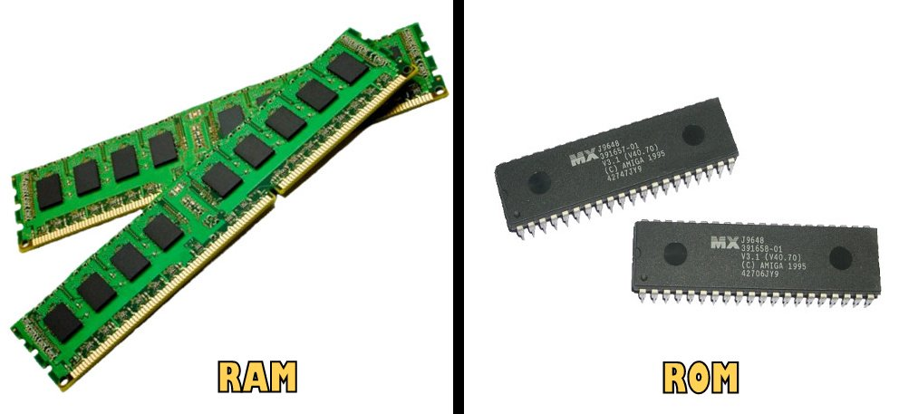
Memory

Slide 23
Storage Devices
Floppy disk - Is a inexpensive, removable, and portable device for storing binary data. They are made of flexible mylar plastic coated with a thin layer of special magnetic material.
Hard disk - Is a non-removable mass-storage device, and has a higher data storage capacity and data transfer speed.

Slide 24
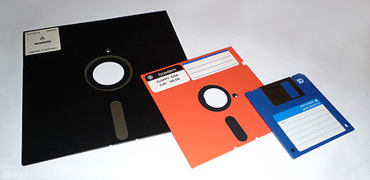
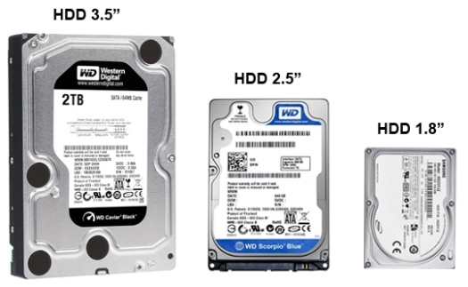
Storage Devices

Slide 25
(cont.) Storage Devices
Syquest cartridge - Is a removable storage medium and can hold 44 MB of data.
Zip cartridge - Is inexpensive and can hold 100MB of data.
Jaz cartridge - Is a removable storage medium that can hold 1GB of data.
Magneto-optical drive - Is rewriteable and uses a high power laser. It is suitable for archiving data.

Slide 26
(cont.) Storage Devices
Digital Versatile Disc (DVD):
  Is an optical disc technology for distributing multimedia and feature length movies.
  Can store up to 10GB of data. They provide sharp and detailed video resolution.
  The two types of DVDs are DVD-video and DVD-ROM.

Slide 27
(cont.) Storage Devices
Compact disc read-only memory (CD-ROM) player - Is an important delivery medium for large, mass-produced multimedia projects.
CD Recordable (CD-R) - Is very inexpensive, and suitable for short-run distribution of finished multimedia projects. These write-once CDs can be used as high-capacity file archives.

Slide 28
Input Devices
Keyboard - Is the most commonly used input device. The most common keyboard for PCs is the 101 style, which provides 101 keys.
Mouse - Is the standard input device for a graphical user interface (GUI).

Slide 29
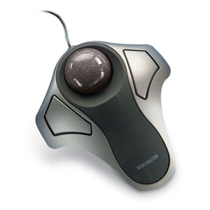
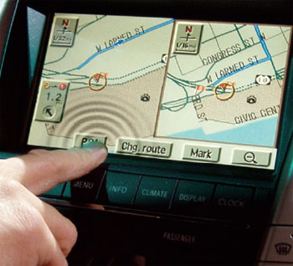
(cont.) Input Devices
Trackball - It is suitable to small confined environments such as a portable laptop.
Touchscreen - They are monitors that usually have a textured coating across the glass face

Slide 30
(cont.) Input Devices
Magnetic card encoder and reader - Is useful when an interface is needed for a database application or multimedia project that tracks users.
Graphic tablet - Provides great control for editing finely detailed graphic elements.
Scanner - Is the most useful device for producing multimedia. They are categorized as flat-bed, handheld, and drum.

Slide 31
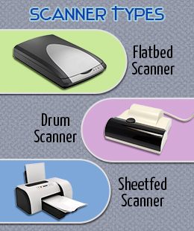
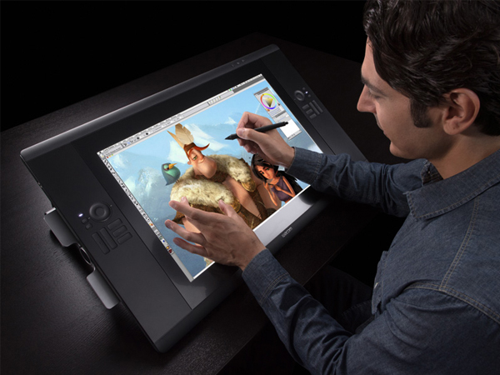
(cont.) Input Devices

Slide 32
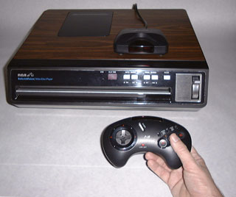
(cont.) Input Devices
Optical Character Recognition (OCR) device - is used to convert printed matter into ASCII text files.
Infrared remote - is used to interact with the project when the user needs to move about.

Slide 33
(cont.) Input Devices
Voice recognition system - Is used to facilitate hands-free interaction with the project.
Digital camera - Is used to capture still images of a specific resolution, and store them in camera’s memory. These images can then be uploaded to a computer.

Slide 34
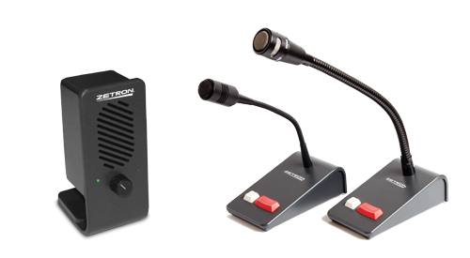
Output Devices
Audio devices:
  They include sound chips and microphones.
  Amplifiers are required when the project has to be presented to a large audience or in a noisy setting.
  Speakers can be internal or external.

Slide 35
(cont.) Output Devices
Video devices:
  Video creates the maximum visual impact.
  Video devices include videodisc players and video cards.
  Videodisc players provide precise control over the image being viewed.
  Video cards enable the user to place an image in a window on the computer monitor.

Slide 36
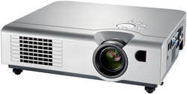
(cont.) Output Devices
Projectors:
  Projectors are used when you have a larger audience that can be accommodated around a computer monitor.
  The different types of projectors include cathode-ray tube (CRT), liquid-crystal display (LCD) panels, stand-alone LCD projectors, and light-valve

Slide 37
(cont.) Output Devices
Projectors (continued):
  CRT projectors are compatible with the output of most computers as well as televisions.
  LCD panels are portable devices that are popular for on-the-road presentations.
  Light-valve projectors use liquid crystal technology. The images generated are very bright and color saturated and can be projected onto wide screens.

Slide 38
(cont.) Output Devices
Printers:
  The two types of printers are laser and inkjet.
  Laser printers offer higher print quality, lower operating costs, but a higher initial cost.
  Inkjet printers are comparatively cheaper, but require higher maintenance.
  Color printers have become an important part of multimedia development.

Slide 39
Communication Devices
Modems
ISDN
Cable modems

Slide 40
Modems
Modems modulate and de-modulate analog signals.
They provide connectivity through standard phone lines.
Modems can be internal or external.
Modem speed is measured in baud, and the standard modem speed should be at least 56 Kbps.

Slide 41
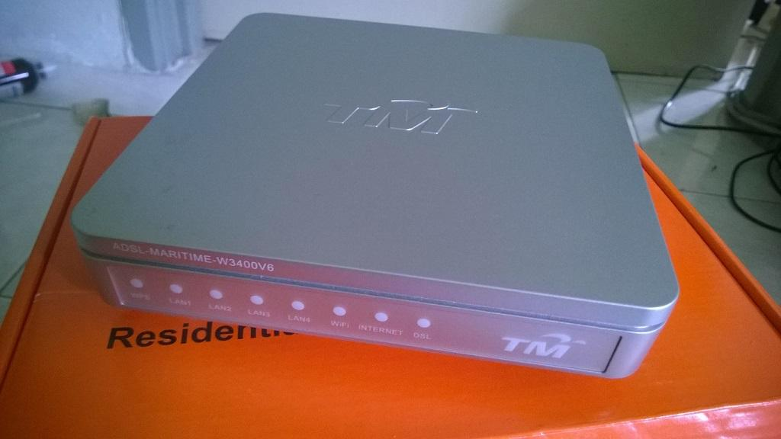
Modems

Slide 42
ISDN
ISDN stands for Integrated Services Digital Network.
It is used for higher transmission speeds by telephone.
They transfer data at the rate of 128 Kbps.
ISDN lines are used for networking, Internet access, and audio-video conferencing.
They are more expensive than the conventional analog lines.

Slide 43
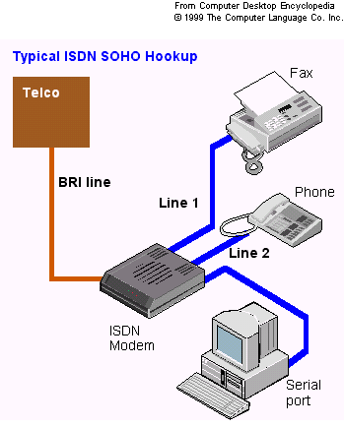
ISDN

Slide 44
Cable Modems
They provide Internet access at speeds faster than a telephone modem, over the same cable network that supplies the television signal.
However, due to noise in the system, sending rates may be much slower than receiving rates.

Slide 45
Summary
Macintosh and Windows are the two most common hardware platforms used in multimedia.
LANs, WANs, Ethernet, and client-server software facilitate communication and connectivity among computers.
Storage devices include floppy disks, hard disks, Zip drives, Jaz drives, MO drives, DVDs, and CD-ROMs.

Slide 46
Summary
Input devices include keyboards, mice, trackballs, touchscreens, graphic tablets, scanners, OCR devices, infrared remotes, voice recognition software, and digital cameras.
Output devices include audio devices, speakers, amplifiers, monitors, video devices, projectors, and printers.
Communication devices include modems, ISDN lines, and cable modems.

