Slide 1
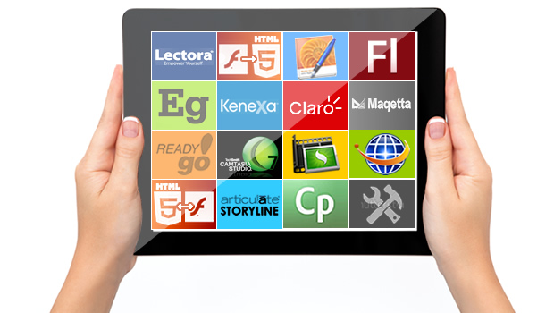
TOPIC 9 – MULTIMEDIA AUTHORING TOOLS
Arranged by :
MOHD SAIFULNIZAM ABU BAKAR
saiful.uitm.edu.my

Slide 2
Overview
Introduction to multimedia authoring tools.
Types of authoring tools.
Cross-platform authoring notes.

Slide 3
Introduction
Multimedia authoring tools provide the framework for organizing and editing the elements of a multimedia project.
Authoring software provides an integrated environment for combining the content and functions of a project.
It enables the developer to create, edit, and import data.

Slide 4
(cont.) Introduction
Most authoring systems also support a scripting language for more sophisticated applications.
Authoring tools require less technical knowledge to master and are used exclusively for applications that present a mixture of textual, graphical, and audio data.

Slide 5
(cont.) Introduction
Four main perspectives in multimedia authoring tools:
Tool (any software package that could authors multimedia product)
Product (the result of combining all multimedia components)
Developer (designers, programmers, and multimedia authors)
End user (customer or viewer)

Slide 6
What You Need: Authoring Systems
Helpful ways to get started:
Use pre-made templates, wizards, and styles to save time on page setup.
Improve document appearance with tables, bulleted and numbered lists, and symbols.

Slide 7
Multimedia Authoring Tools
Authoring system in multimedia.
Features of authoring tools.

Slide 8
Authoring Systems in Multimedia
In multimedia authoring systems, multimedia elements and events are often regarded as objects.
Objects exist in a hierarchical order of parent and child relationships.
Each object is assigned properties and modifiers.
On receiving messages, objects perform tasks depending on the properties and modifiers.

Slide 9
Features of Authoring Tools
Editing and organizing features.
Programming features.
Interactivity features.
Performance tuning and playback features.
Delivery, cross-platform, and Internet playability features.

Slide 10
1- Editing and Organizing features
Authoring systems include editing tools to create, edit, and convert multimedia elements such as animation and video clips.
The organization, design, and production process for multimedia involves storyboarding and flowcharting.
Visual flowcharting or overview facility illustrates project structure at a macro level.

Slide 11
2- Programming features
Visual programming with icons or objects is the simplest and easiest authoring process.
Visual authoring tools such as Authorware and IconAuthor are suitable for slide shows and presentations.
Authoring tools offer ‘very high level language’ (VHLL) or interpreted scripting environment.

Slide 12
3- Interactivity Features
Interactivity gives the end user control over the content and flow of information in a project.
Simple branching is the ability to go to another section of the multimedia production.
Conditional branching is an activity based on the results of IF-THEN decisions or events.
Structured language supports complex programming logic, subroutines, event tracking, and message passing among objects and elements.

Slide 13
4- Performance Tuning and Playback Features
Achieving synchronization is difficult, considering that performance of the different computers used for multimedia development and delivery varies.
Authoring system should facilitate precise timing of events.
It should enable developers to build a part of a project and then test it immediately.

Slide 14
5- Delivery, Cross Platform and Internet Playability Features
Delivering the project may require building a run-time version of the project, using the multimedia authoring software.
Run-time version or standalone allows a project to play back without the complete authoring software and all its tools and editors.

Slide 15
Delivery, Cross Platform and Internet Playability Features
It is important to use tools that facilitate easy transfer across platforms.
Authoring systems provide a means for converting their output to be delivered within the context of HTML or DHTML.

Slide 16
Types of Authoring Tools
Card- and page-based tools.
Icon-based, event-driven tools.
Time-based tools.

Slide 17
1- Card and Page-based Tools
Card- and page-based authoring systems provide a simple and easily understood metaphor for organizing multimedia elements.
Cards are developed that have different elements associated with them and are put in stacks. It contains media objects such as buttons, text fields, and graphic objects.

Slide 18
1- Card and Page-based Tools
It provides a facility for linking objects to pages or cards. You can link the cards by allowing the user to click on buttons or other elements and jump to a different card in the stack.
Example : Hypercard, ToolBook, HyperNext Studio, Hyper Studio, PhytonCard, LiveCode by Revolution

Slide 19
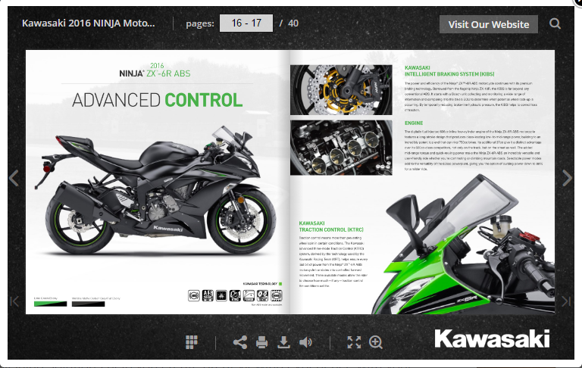
(cont.) Card and Page-based Tools
Example : Flip Book
https://flippingbook.com/online-flipbook

Slide 20
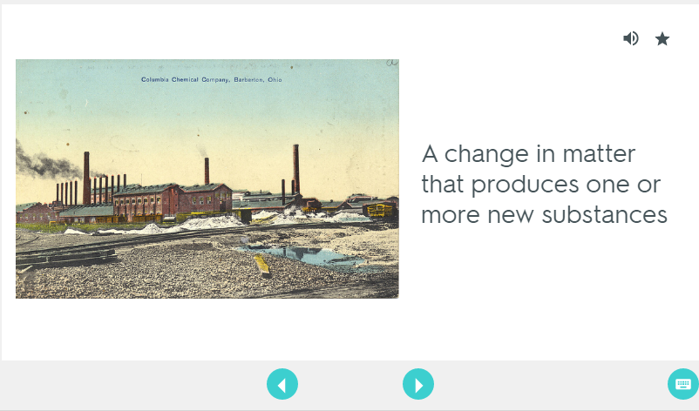
(cont.) Card and Page-based Tools
Example: Quizlet Flash Card https://quizlet.com/38274736/flashcards

Slide 21
(cont.) Card and Page-based Tools
Example:
LiveCode from Runtime Revolution (www.runrev.com)

Slide 22
(cont.) Card and Page-based Tools
Example : FlipSnack

Slide 23
2- Icon Based, Event-Driven Tools
Icon-based, event-driven tools provide a visual programming approach to organize and present multimedia.
Multimedia elements and interaction cues are organized as objects in a flowchart.

Slide 24
Icon Based, Event-Driven Tools
Flowchart can be built by dragging appropriate icons from a library, and then adding the content.
With icon-based programs, you use symbols in a flowchart scheme.
Each icon represents a particular event.

Slide 25
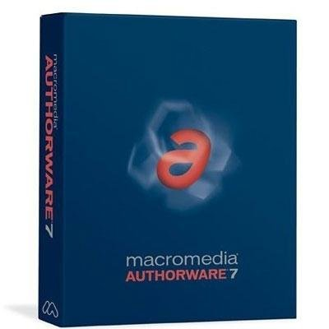
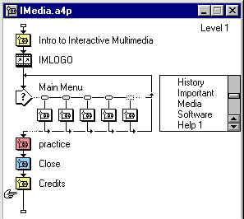
(cont.) Icon Based, Event-Driven Tools
An advantage of icon-based programs is that you can easily see how a title is structured, that is, the flow of a program and especially the branching.
Example : Macromedia Authorware

Slide 26
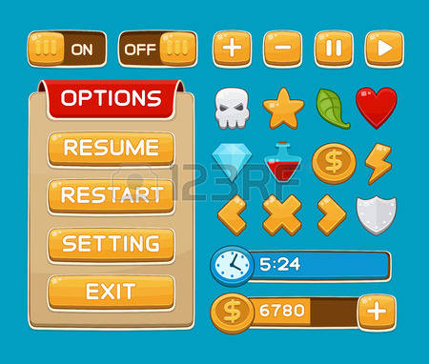
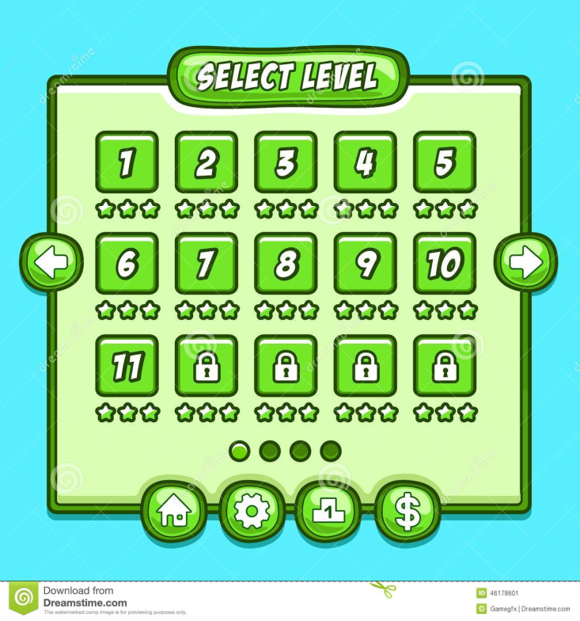
(cont.) Icon Based, Event-Driven Tools
Example

Slide 27
3- Time-Based tools
Time-based tools are best suited for messages with a beginning and an end.
Some time-based tools facilitate navigation and interactive control.
Time Based Authoring Programs use a movie metaphor. Like a movie on videotape, you start the multimedia title and it plays until some action causes it to pause or stop.
Adobe’s Director and Flash are time-based development environments.

Slide 28
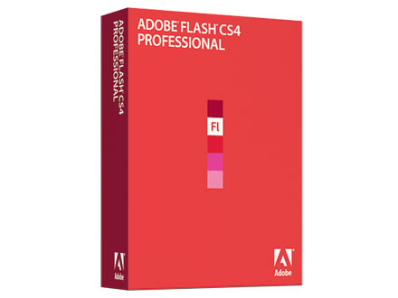
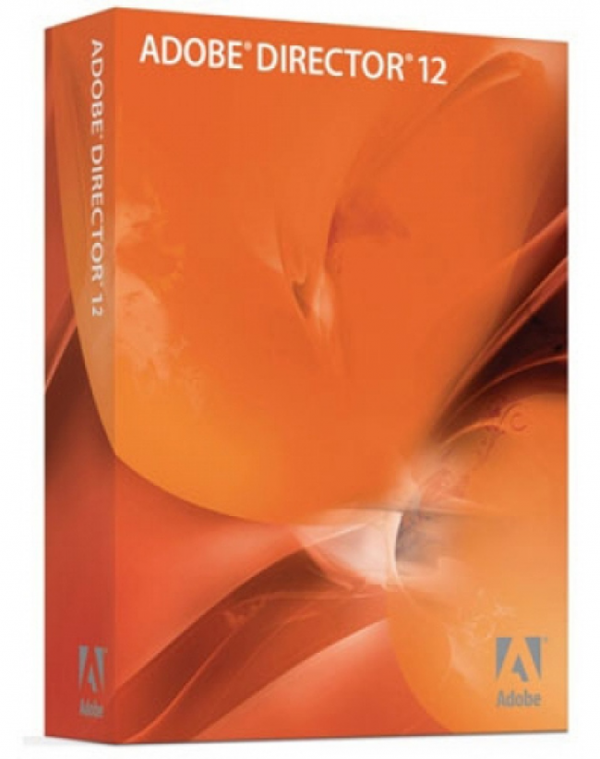
Software

Slide 29
(cont.) Time-Based tools
Macromedia/ Adobe Director:
A multimedia database, ‘Cast’, contains still images, sound files, text, shapes, scripts, movies, and other Director files.
Score is a sequencer for displaying, animating, and playing Cast members.
Lingo is an object-oriented scripting language that enables interactivity and programmed control.

Slide 30
(cont.) Time-Based tools
Adobe Flash:
Flash is used for delivering rich multimedia content to the Web.
Flash Player plug-in installed in more than 95 percent of the world’s browsers,
It allows the creation of simple static HTML pages with the Flash Player plug-in.
ActionScript, the proprietary, under-the-hood scripting language of Flash, is based upon the international ECMAScript standard

Slide 31
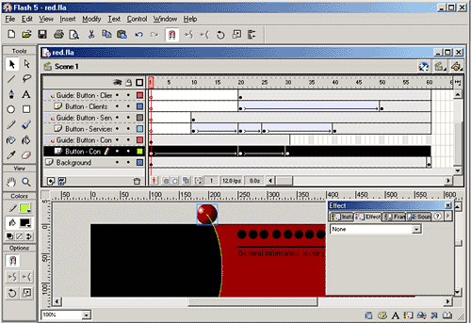
(cont.) Time-Based tools

Slide 32
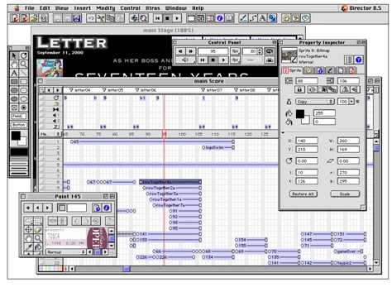

Slide 33
Example
http://html5maker.com/#/templates

Slide 34
Cross-platform Authoring Notes
Macintosh and Windows computers use different schemes to manage text and colors.
While using text fields, ensure that the text displays correctly on both platforms.
Outline and shadow styles on text should be avoided on Macintosh since they are not currently supported in Windows.

Slide 35
Type | Software
Card- Or Page-based | LiveCode, Toolbox,Flipbook ,Quizlet
Icon-based Or Event-driven | Macromedia (Adobe) Authorware
Time-based | Adobe Flash,Director

Slide 36
Summary
Multimedia authoring tools provide the framework needed for organizing and editing multimedia elements in a project.
The three types of authoring tools are card- or page-based, icon-based or event-driven, and time-based.
Text and color compatibility must be verified before moving multimedia projects across platforms.

